Slide 1
Brian Austin, Wahid Bhimji, Tina Butler,
Jack Deslippe, Scott French, Richard Gerber Douglas Jacobsen, Glenn K. Lockwood, Nicholas Wright, Zhengji Zhao
Tools and techniques towards a holistic understanding of I/O demands
Notes:
NERSC
a big facility with a lot of users and applications,
rely on IO characterization to look forward and design future systems

Slide 2
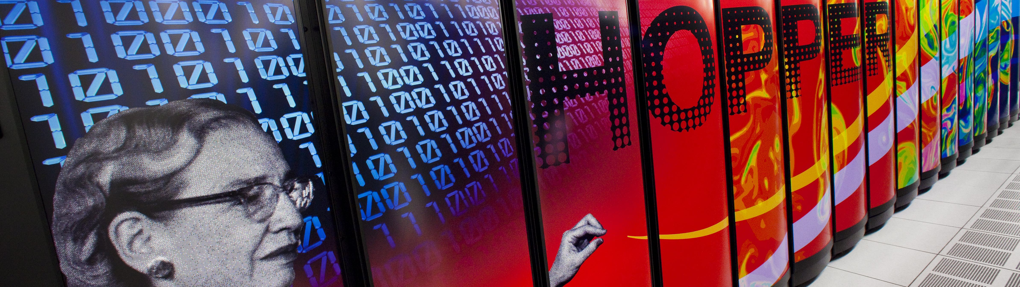

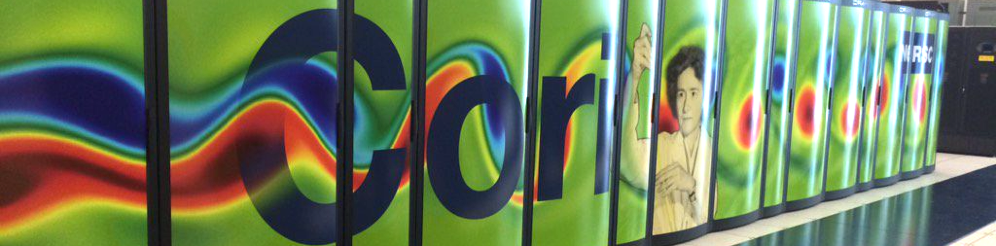
Filesystem | /scratch | /scratch2 | Total
Capacity | 1.1 PB | 1.1 PB | 2.2 PB
Bandwidth | 35 GB/s | 35 GB/s | 70 GB/s
OSSes | 26 | 26 | 52
Filesystem | /scratch1 | /scratch2 | /scratch3 | Total
Capacity | 2.1 PB | 2.1 PB | 3.2 PB | 7.4 PB
Bandwidth | 48 GB/s | 48 GB/s | 72 GB/s | 168 GB/s
OSSes | 24 | 24 | 36 | 84
Filesystem | DataWarp | /cscratch
Capacity | ~0.75 PB | 28.5 PB
Bandwidth | ~750 GB/s | 744 GB/s
OSSes |  | 248
Notes:
3 systems
Lustre-based scratch file systems
with gpfs too
and now datawarp

Slide 3

NERSC's Current Monitoring Framework
compute nodes
IO forwarders
storage servers
Darshan
LMT
SQL
HDF
Notes:
two-pronged approach to current monitoring
users can self-service front- and back-end data via web
facilities staff get system-wide metrics for planning
we see some interesting things. for example…

Slide 4
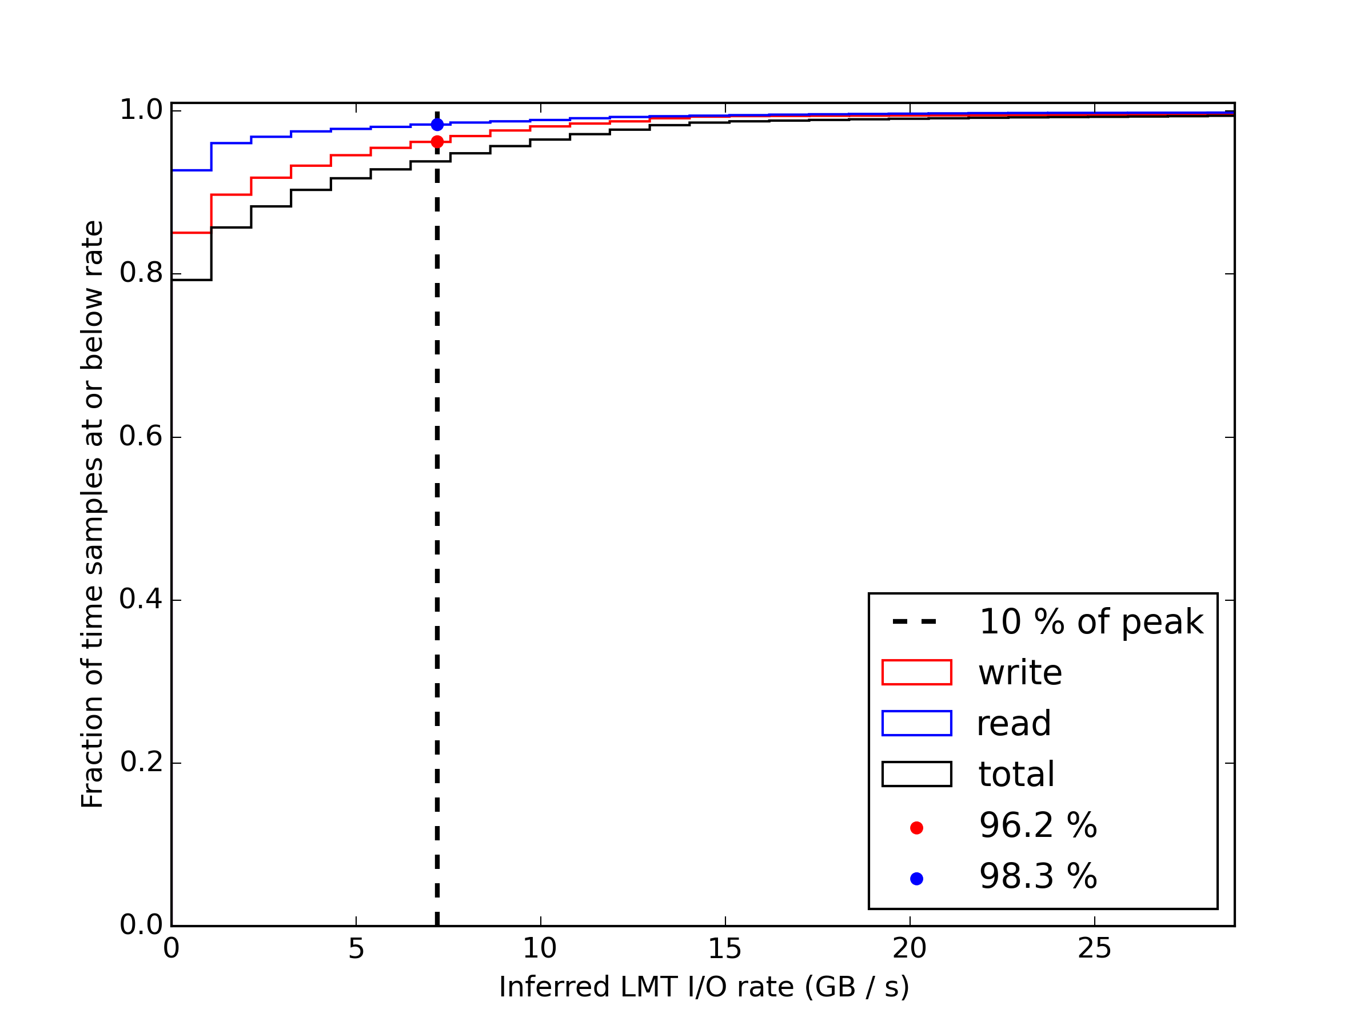
Lustre Bandwidth Demand in Practice
Edison /scratch3
File systems never show > 10% of peak more than 10% of the time
99% of /scratch3 samples show less than 20 GB/s (27% of peak)
10% of peak filesystem bandwidth
Notes:
our file systems are not driving near their limit – this motivated BBs

Slide 5
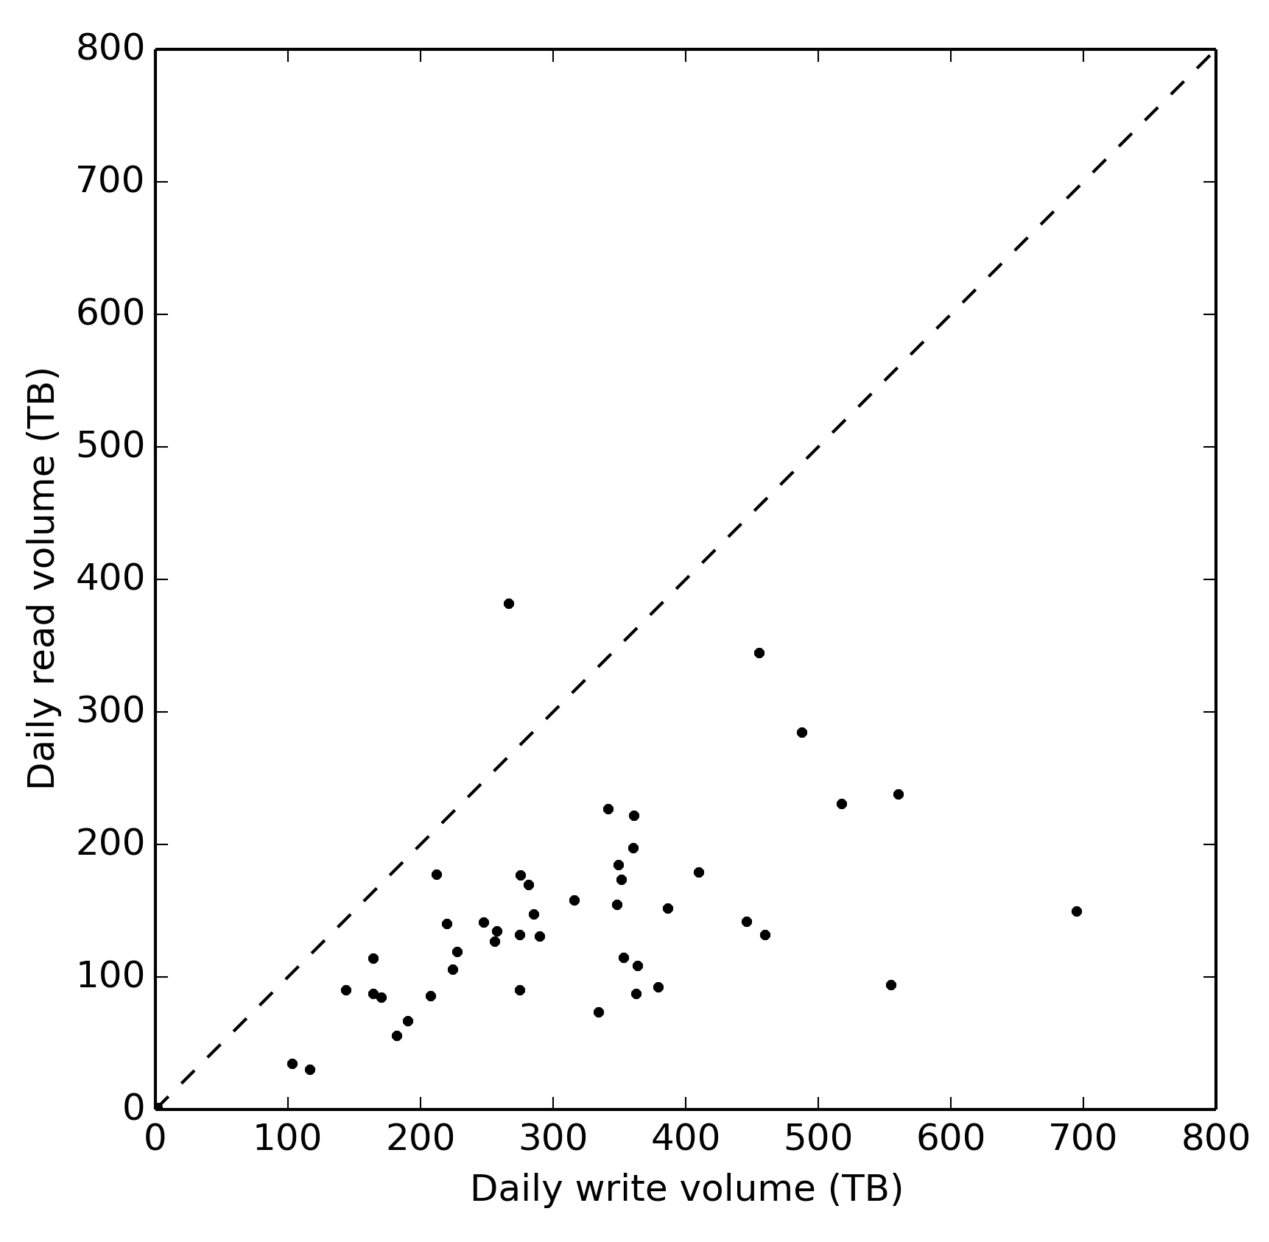
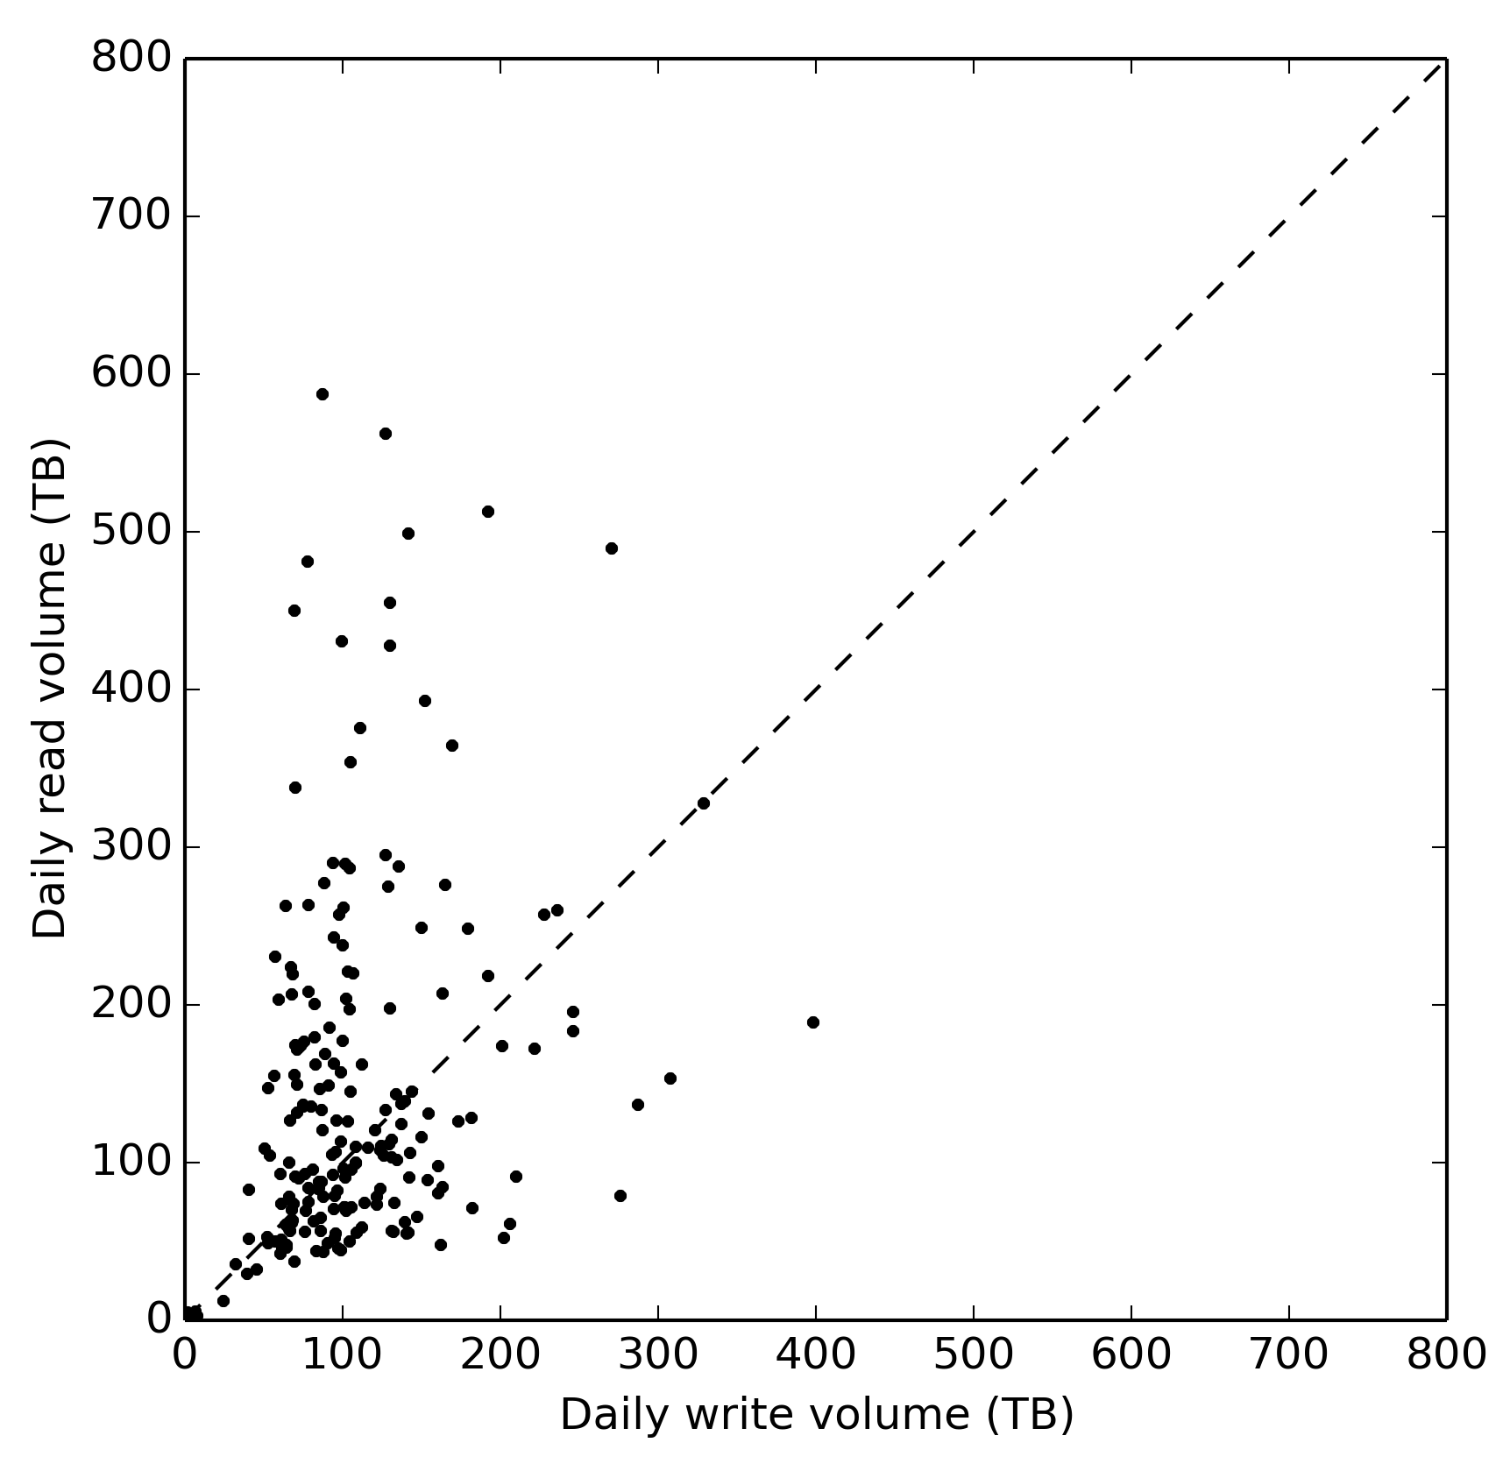
Read/Write Ratios
Avg daily reads
Hopper: 140 TB/day
Edison: 140 TB/day
Avg daily writes
Hopper: 105 TB/day
(~50% RAM)
Edison: 303 TB/day
(~84% RAM)
Read / write balance
read-heavy
Daily Averages
Hopper:
Edison:
write-heavy
Daily read volume (TB)
Edison (Total Memory = 357 TB)
Hopper (Total Memory 217 TB)
Daily write volume (TB)
Notes:
read/writes per day sprayed on a scatter plot reveal
contrast – Edison has a much larger write workload
function of system lifecycle?
Edison checkpointing more because it's less stable?

Slide 6
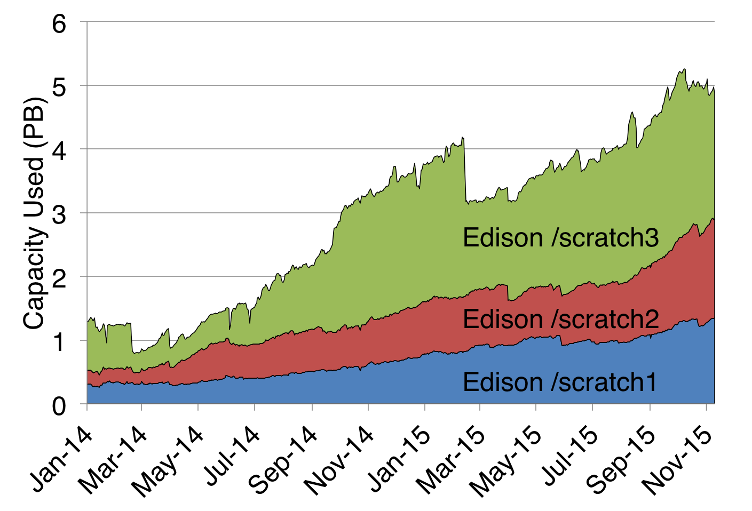
Scratch growth rate: 9.4 TB/day
cf. 300 TB/day write rate
Notes:
if we look at growth, we see only 9.4 TB/day in growth
vs 300+ TB/day written
30x difference implies rewrites

Slide 7
Checkpointing I/O Workload
> 70% core hours are from jobs that reach the wallclock limit
Notes:
indirect indicators of IO provide additional insight
this is very basic, but it is an example of how additional data sources expose more insight

Slide 8
NERSC's Holistic Monitoring Framework
compute nodes
IO forwarders & Burst Buffers
storage servers
collectd
(dvs, lnet, dw)
Darshan
(apps)
collectd
(fs)
Fabric
counters
Fabric
counters
LMT
DDNtool
AMQP Bus
Notes:
now moving towards multifaceted monitoring
fabric routing counters
IO forwarders, DataWarp
backend disk performance

Slide 9
NERSC's Holistic Monitoring Framework
Darshan records
collectd records
LMT records
…
AMQP Bus
File system
Organized views
Analyzers
Query
Interface
Correlated view analysis
Statistical analysis
…
Notes:
data only useful if accessible, so we are building an analysis layer
expose data as various views
common (& custom) analysis modules

Slide 10
The Harder I/O Questions
What is the effect of application interference on IO?
How do workflows use and modify data across time and over multiple jobs?
How can we manage the burst buffer as a new performance resource?
How can we integrate with the surrounding ecosystem to facilitate new data modalities?
Notes:
goal is to answer higher-order questions

Slide 11
Full 2014 Workload Analysis https://www.nersc.gov/research-and-development/apex/
Ongoing work funded by the DOE ASCR SSIO program

Slide 12
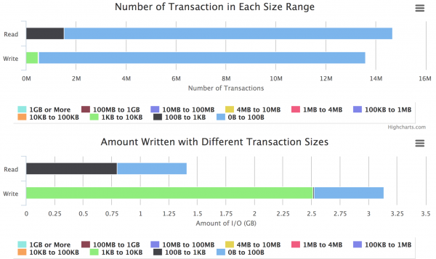
User-facing I/O analysis: Front-end

Slide 13
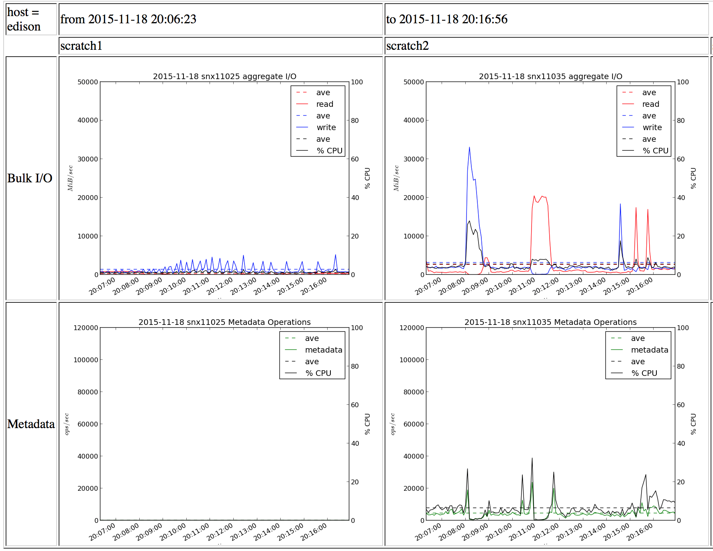
User-facing I/O analysis: back-end

Slide 14
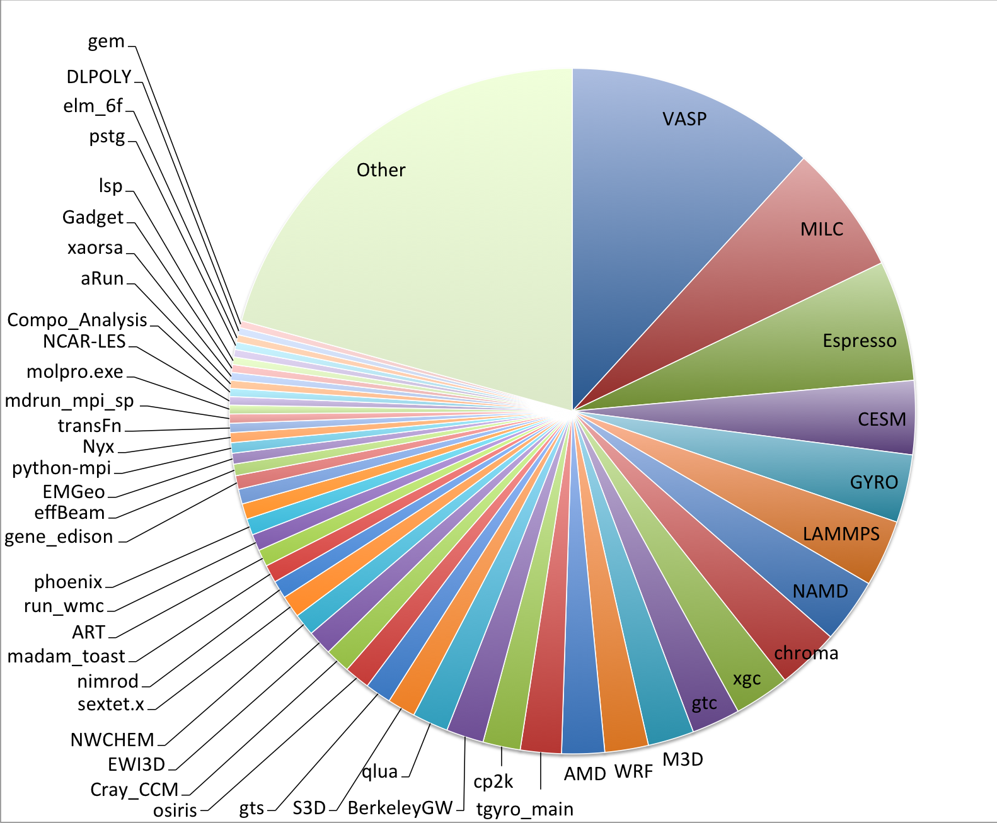
NERSC Workload Diversity
Applications on Hopper and Edison by hours used
January 2014 – December 2014
6,000 users
850 projects
10 codes = 45% of cycles
25 codes = 66% of cycles
50 codes = 80% of cycles
"Other" > 600 codes (20%)

Slide 15
What causes performance variation?
Notes:
%variation = FWHM / Mode
Posix-I/O: 297 samples
MPI-I/O: 182 samples
Cron job measures performance of IOR benchmark each week.
I/O benchmarks routinely measure large fractions of peak bandwidth.
“Typical” measurements are 25-40% slower.
30-50% variation
A few runs are much slower.

Slide 16
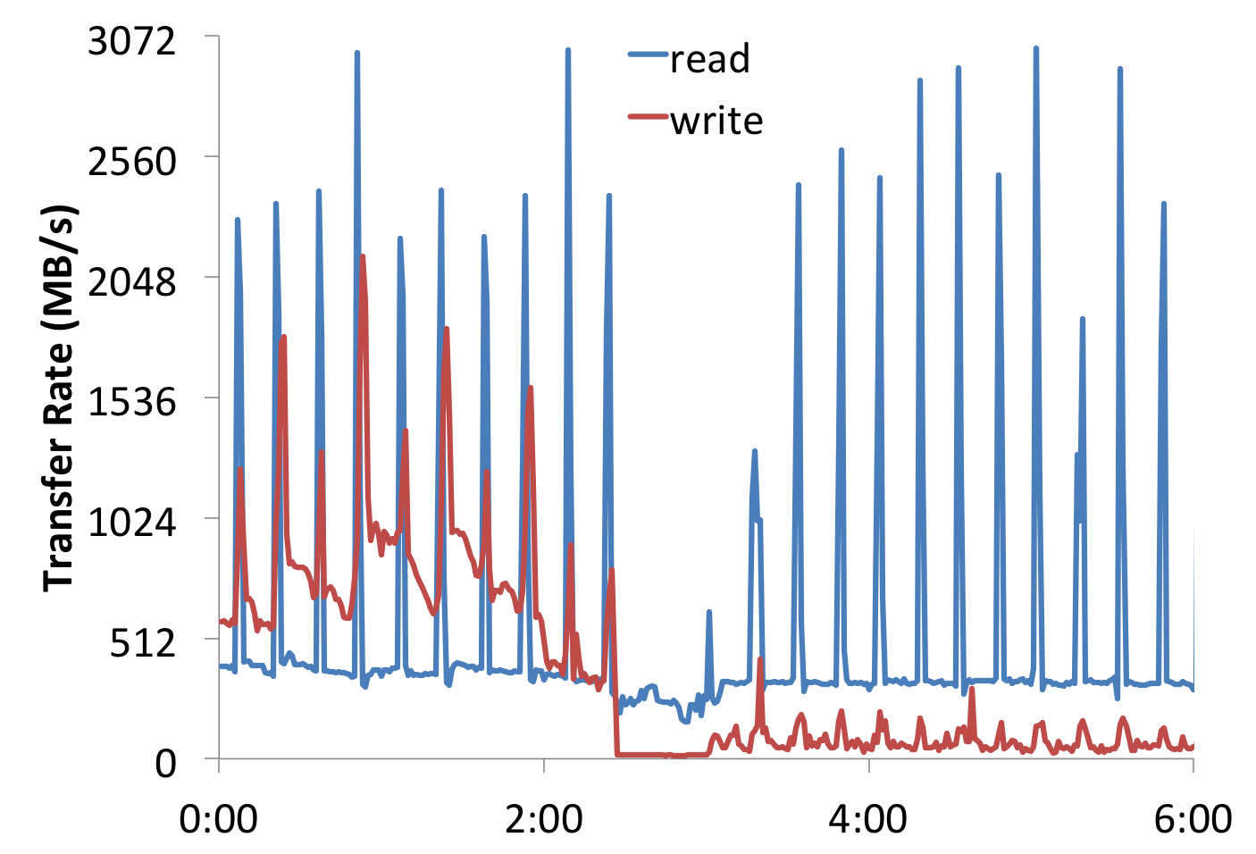
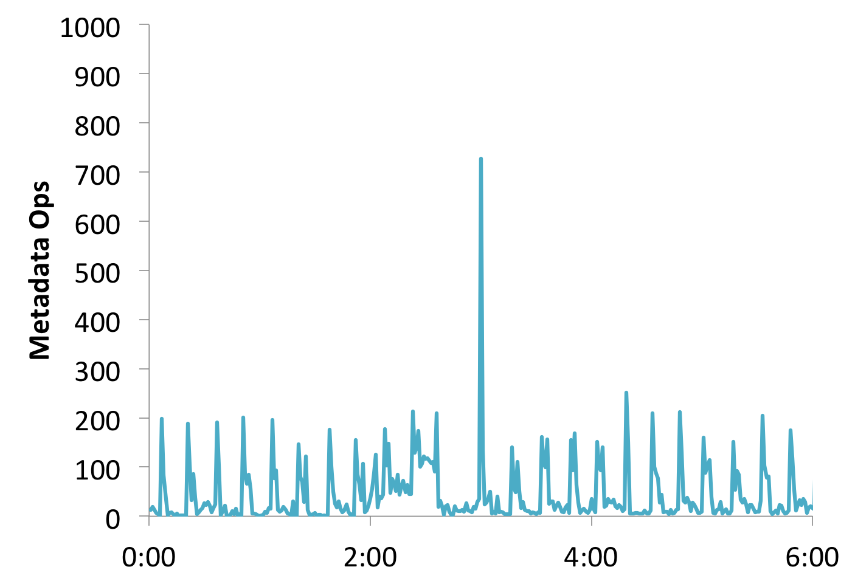
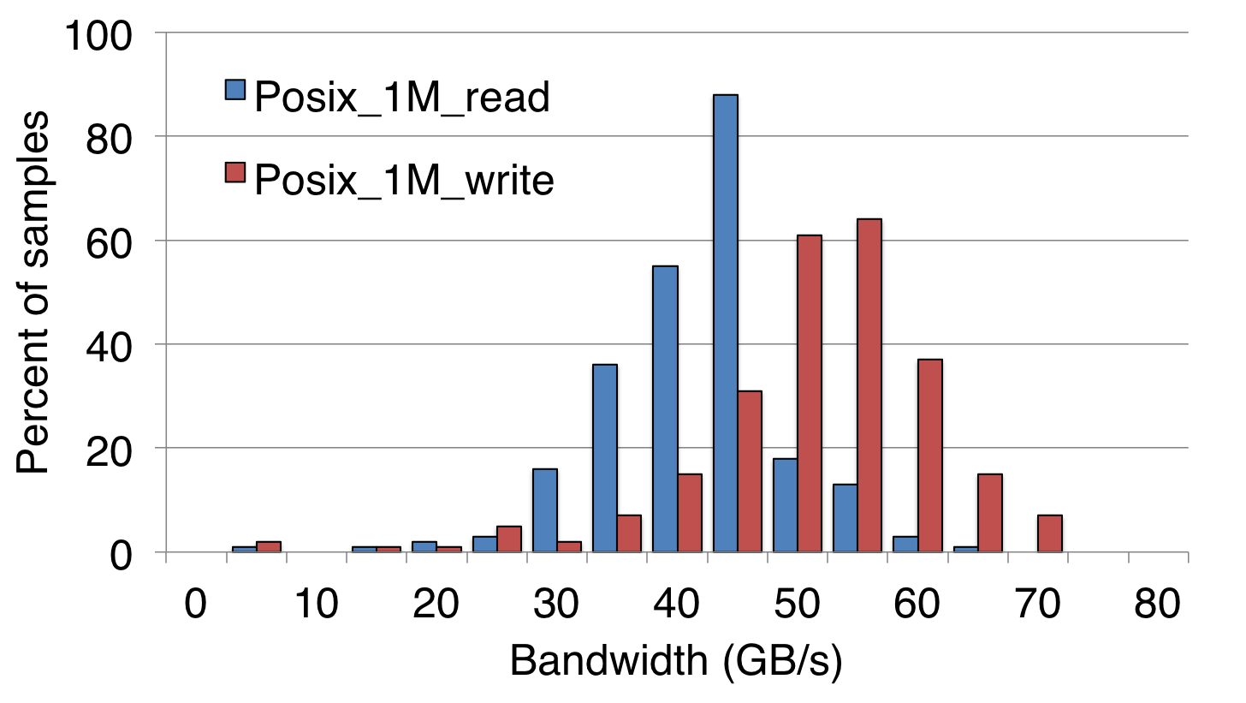
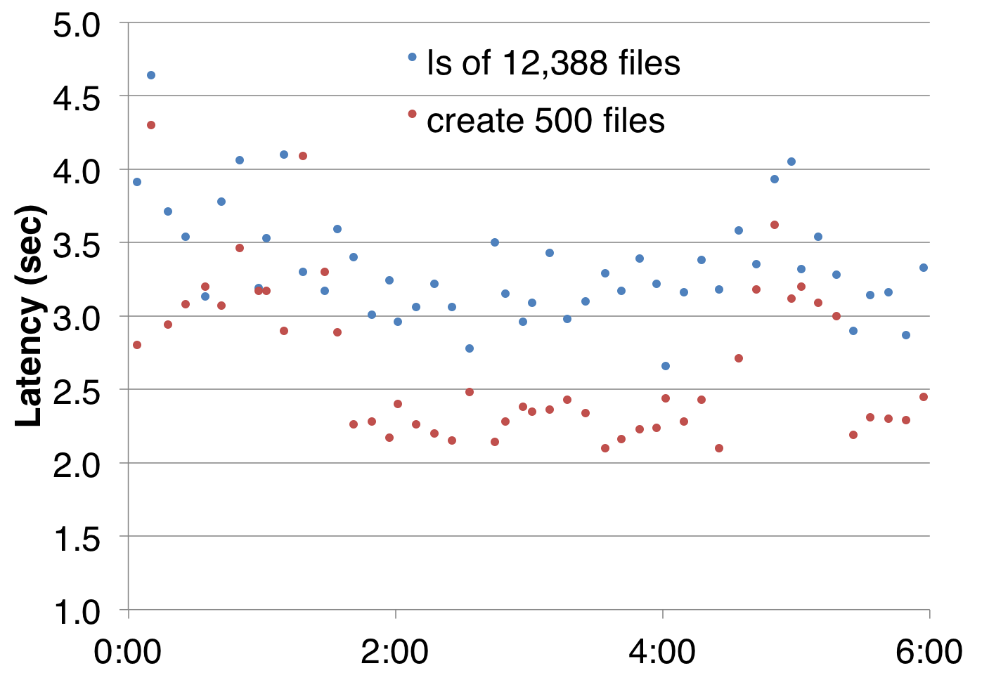
Drill down through I/O stack
Back-end metadata rate
Backend transfers (LMT)
Front-end metadata response
(probes)
Notes:
%variation = FWHM / Mode
Posix-I/O: 297 samples
MPI-I/O: 182 samples
Cron job measures performance of IOR benchmark each week.
I/O benchmarks routinely measure large fractions of peak bandwidth.
“Typical” measurements are 25-40% slower.
30-50% variation
A few runs are much slower.

