Slide 1
Unstructured Grids at
Sandia National Labs
Jay Lofstead (with help from Paul Lin)
Scalable System Software
Sandia National Laboratories
Albuquerque, NM, USA
gflofst@sandia.gov
EIUG Workshop
September 25, 2017
SAND2017-10341 C

Slide 2
Where are Unstructured Grids used?
Primarily engineering codes, but many simulations as well
  Finite volume
  Finite element
  Particle in cell
Sierra application family (https://sierradist.sandia.gov/)
  Challenges Addressed
    Coupled multiphysics: solid+fluid+thermal+chem.
    Large unstructured meshes: 10,000,000,000s elements
      (5-10 doubles/element)
    Massively parallel computing: 100,000s of processors
    Advanced algorithms: mesh erosion, h-adaptivity, multilevel, dynamic load balancing
ATDM
  SPARC (FV) – re-entry widget in atmosphere
  Empire (EM) – electromagnetic field
Notes:
SIERRA -- A Computational Framework for Engineering Mechanics Applications (http://graphics.stanford.edu/sss/sierra_stanford_april02.pdf)
https://www.osti.gov/scitech/servlets/purl/1145754

Slide 3
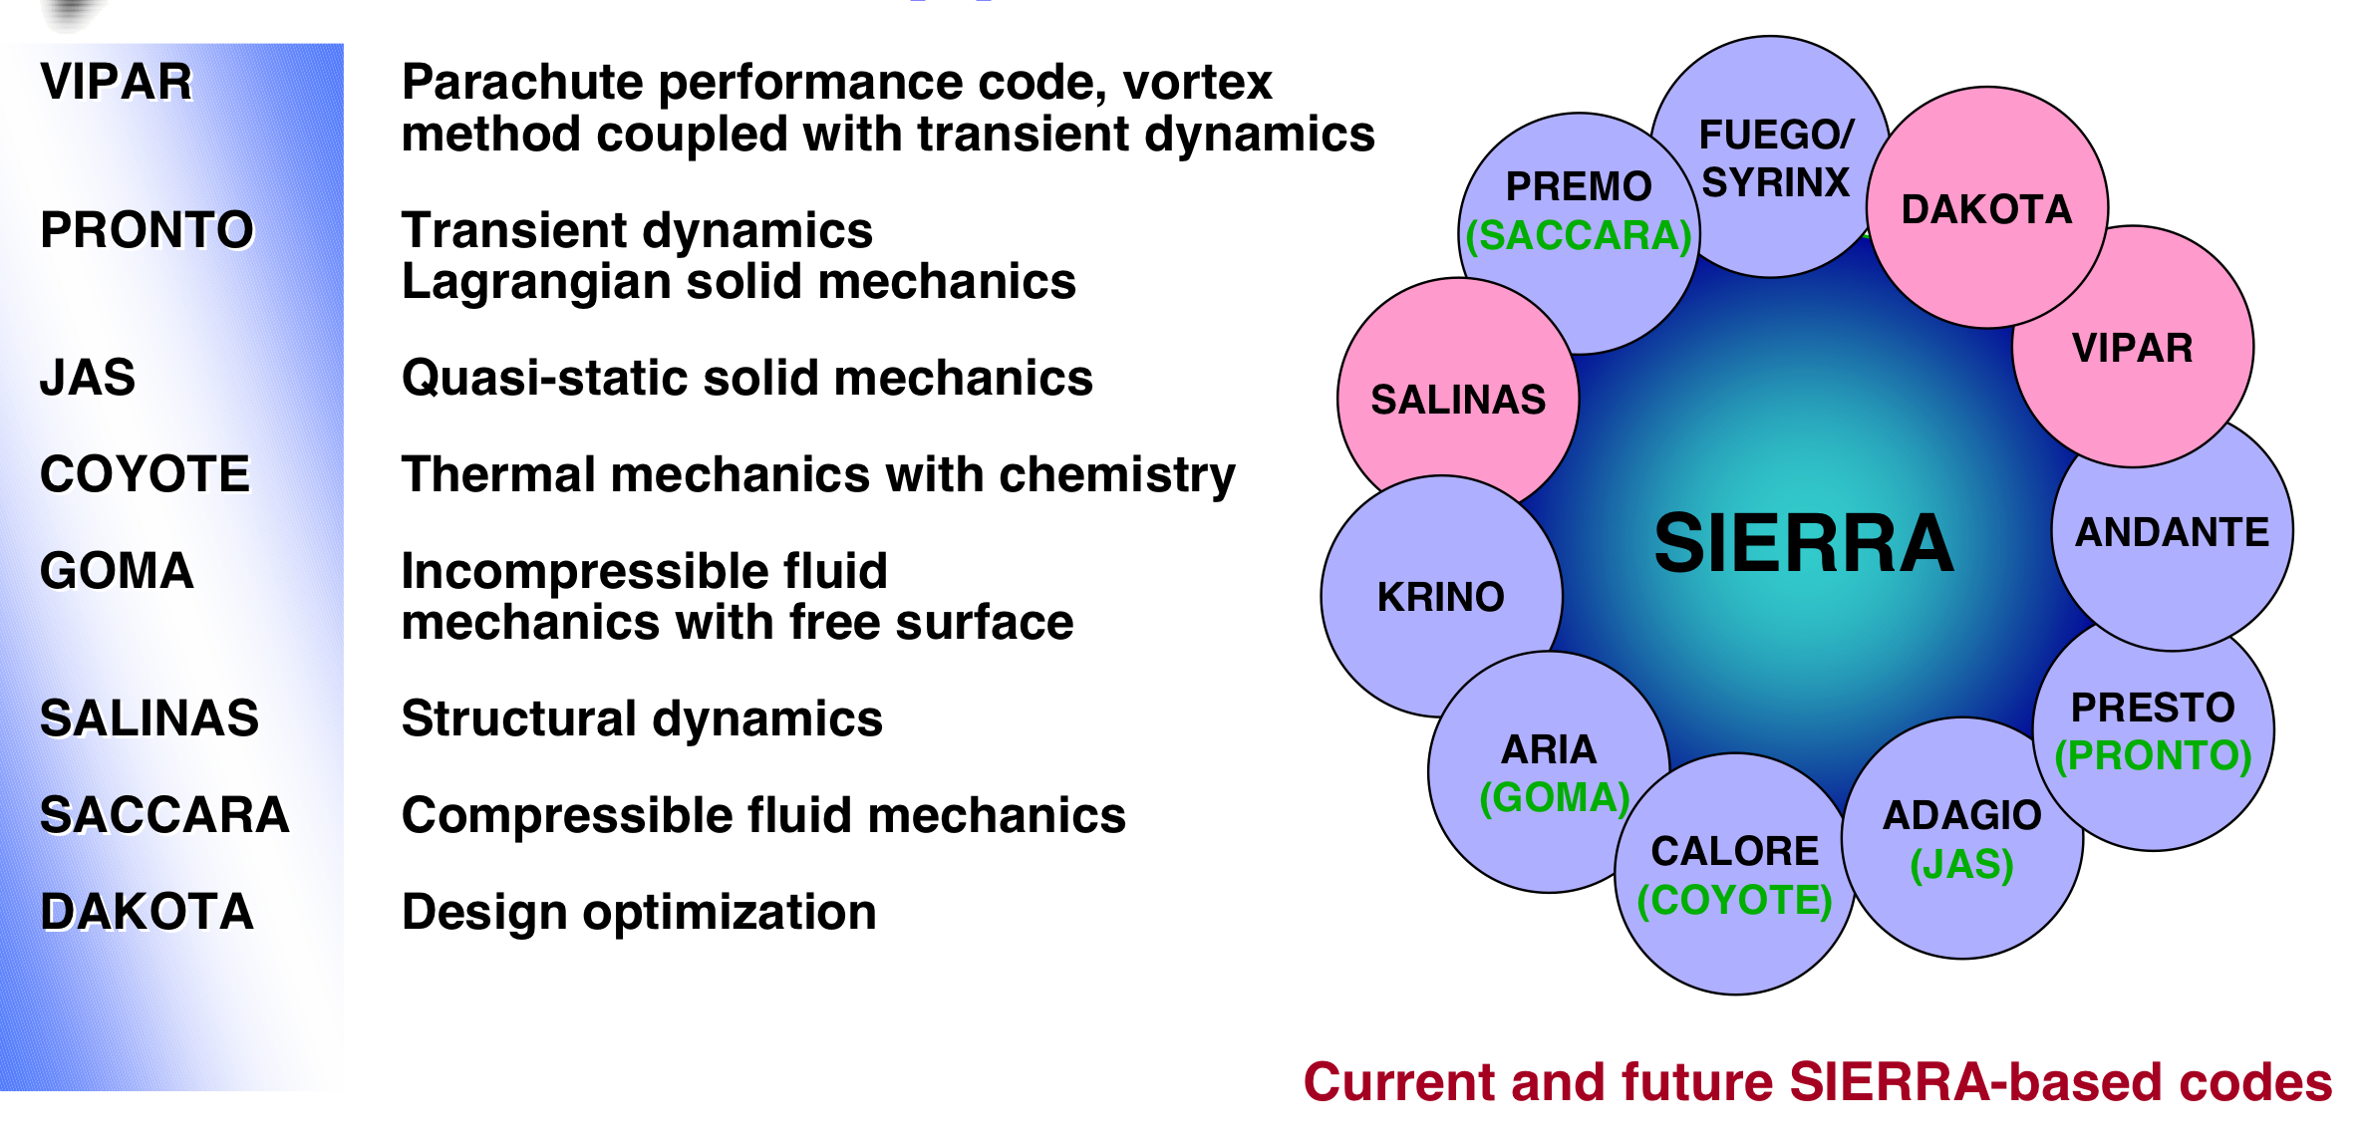
Sierra Applications

Slide 4
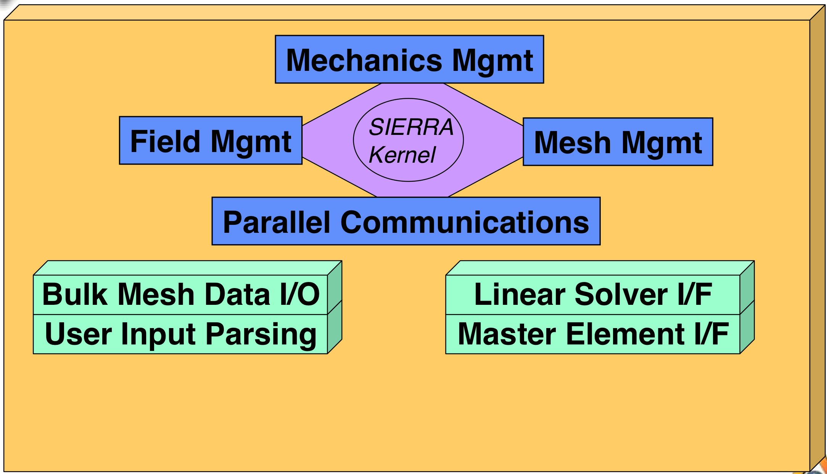
Sierra Architecture

Slide 5
Platforms we run on
Sequoia (LLNL) 17 PF
  98304 nodes, 1.57 million compute cores, 1.6 PB RAM
Trinity (SNL/LANL) > 40 PF
  19000 nodes, 301,000 cores Xeon + KNL, ~2 PB Ram
We currently run full machine jobs on both machines and would like to run much larger!

Slide 6
Output Frequency
Steady State applications
  E.g., aircraft wing design at high velocity to see where the pressure point develops
  Single output when calculation stabilizes
Non-steady state applications
  E.g., SPARC calculations of temperature, pressure and velocity over a path
  Output periodically, ~ every 10 timesteps
Data sizes are O(1PiB) for large runs!

Slide 7
Underlying Computation Frameworks
Wide variety
  Trilinos linear algebra family (C++ and fully templetized)
    17 years old and starting to make inroads (Epetra and now Tpetra)
    Can do FE/FV well, but not recognized as great for other setups
    Physics really determines if it can be used more than anything else
  Hand-coded frameworks
    Built over time and optimized for exactly the problem at hand
    Very fast, but must be maintained
    Speed makes moving to something general like Trilinos unattractive.
  Others
    E.g., PetSc (Fortran interface available)

Slide 8
Common IO interface
IO Interface is standardized for Sierra (IOSS)
  Standardized interface for reading and writing to various formats
    Does meshes and/or data
    Also used for code coupling
  Exodus II interface is for file IO
    NetCDF is the underlying format, 1 file per process, but moving to 1 file
  Nemesis: Exodus II extension for unstructured parallel finite element analyses. Adds data structures helpful in partitioning
  Fortran array ordering is generally standard

Slide 9
Exodus II
Optimized calls tailored to the Sierra (unstructured grid) applications on top of NetCDF
  Long developed and proven to be both sufficient and effective.
Currently 1 file per process with a data redistributor process to change the distribution for a different sized run
  Running into Lustre metadata server limits and sheer parallel access to the PFS
Moving to 1 file total (still with NetCDF underneath)
  Thought this would solve all problems, but will introduce new problems.
Sandia analysis applications all know how to read and use these files.
Notes:
http://prod.sandia.gov/techlib/access-control.cgi/1992/922137.pdf

Slide 10
Nemesis
Focus on parallel extensions to Exodus II to make things easier to manage.
This helps a lot with load balancing
Strict superset of Exodus II API, but 100% backwards compatible file organization and contents.
Still have lots of files and potentially manual manipulation.
Notes:
https://www.researchgate.net/publication/255655344_NEMESIS_I_A_Set_of_Functions_for_Describing_Unstructured_Finite-Element_Data_on_Parallel_Computers

Slide 11
Futures
Data tagging
  Annotate blocks or variables for the presence of a value of threshold (min/max)
  Identify feature existence from lightweight analysis
Tagging granularity varies
  Some applications more at the element level, others at the region or whole variable level
  Physics affects what sort of tagging is useful/important
Actually efficient storage and access for parallel codes

Slide 12
ATDM
Multi-physics in asynchronous many task framework
Faodail (Data Warehouse component) offers both AMT integrated service as well as workflow/external access
Making this scalable is challenging (PIC codes with the communication patterns can be slow)

Slide 13
Questions?
What else can I tell you about?

