Slide 1
Percipient StorAGe for Exascale Data Centric Computing Exascale Storage Architecture based on “Mero” Object Store Giuseppe Congiu Seagate Systems UK DKRZ I/O Workshop 22/03/2017
Per-cip-i-ent (pr-sp-nt)
Adj.
Having the power of perceiving, especially perceiving keenly and readily.
n.
One that perceives.
Notes:
This presentation outlines the architecture of the SAGE percipient storage system

Slide 2
Storage cannot keep up w/ Compute!
Way too much data
Way too much energy to move data
New Storage devices use unclear
Opportunity: Big Data Analytics and Extreme Computing Overlaps
Storage Problems at Extreme Scale
Notes:
1 – denser compute components (MIC, GPGPUs)
2 – larger datasets and larger and more complex workflows
3 – rethink workflows (HPC vs BDA)
4 – parallel file systems too dumb we need percipient storage that can do both HPC and BDA (BDEC)
5 – we need to minimize data movement at exascale
6 – plus we have new storage devices

Slide 3
Extreme
Computing
Changing I/O needs
HDDs cannot keep up
Big (Massive!) Data Analysis
Avoid Data Movements
Manage & Process extremely large data sets
Need Exascale Data Centric Computing Systems
Big Data Extreme Computing (BDEC Systems)
SAGE Validates a BDEC System which can Ingest, Store, Process and Manage extreme amounts of data
SAGE Project Goal
Notes:
BDEC term, US labs are starting to build BDEC systems requirements, we are actually building a system here

Slide 4
Research Areas
Notes:
Sage Ecosystem
Areas of Research
Percipient Storage for Function offloading
Programming techniques supporting function shipping
Next Generation media for deeper hierarchies

Slide 5
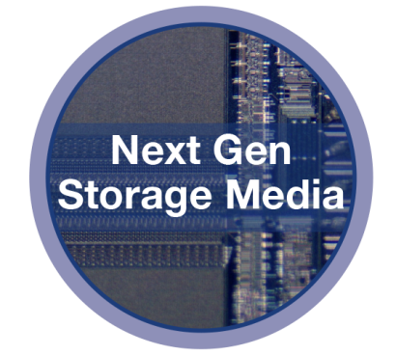
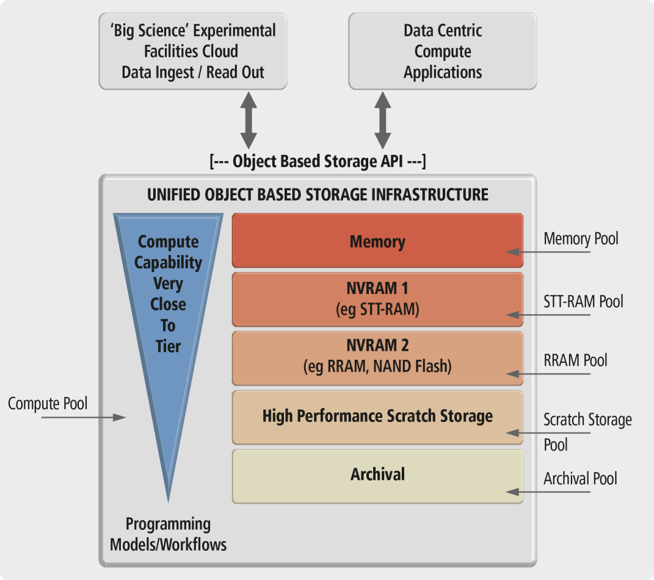
Percipient Storage Overview
Goal
Build the data centric computing platform
Methodology
Advanced Object Storage
New NVRAM Technologies in I/O stack
Ability for I/O to Accept computation
Incl. Memory as part of storage tiers
API for massive data ingest and extreme I/O
Commodity Server & Computing Components in I/O stack

Slide 6
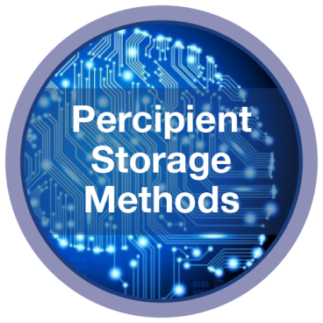
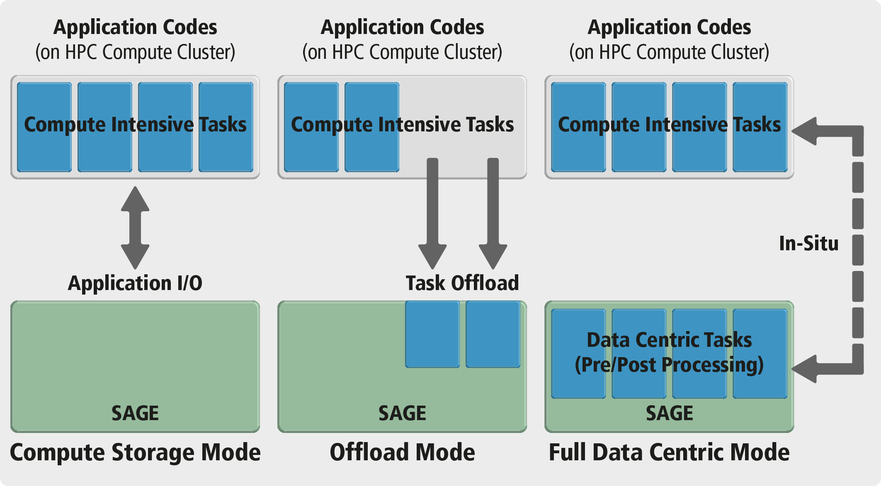
Percipient Storage Modes of Operation

Slide 7
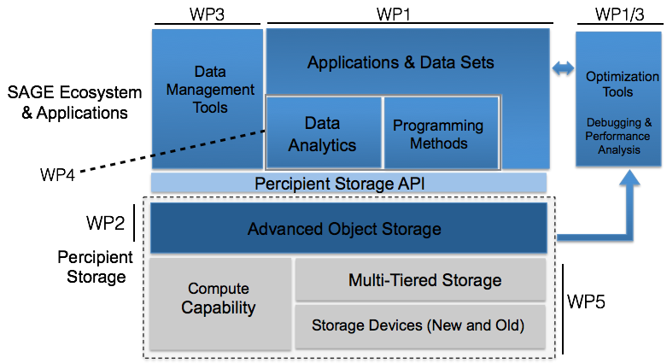
Percipient Storage Architecture
Notes:
Emphasize Optimization tools (ADDB Allinea)

Slide 8
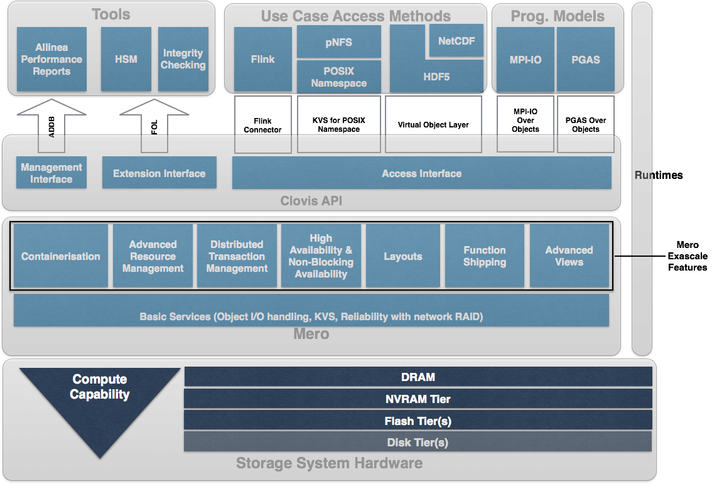
Percipient Storage Architecture ( Detailed)

Slide 9
Primary Goal
Provide monitoring tools with telemetry data
Methodology
Mero has “ADDB” Infrastructure ( Analysis and Diagnostics Data Base)
Structured telemetry records produced by the various subsystems
It will now be exposed through the “Clovis” Management Interface
ADDB Records can feed into tools
Allinea will be consuming ADDB records in the SAGE project
Records can be kept in local Mero nodes and Map-Reduce style analysis can also be performed
Perspective on Monitoring..

Slide 10
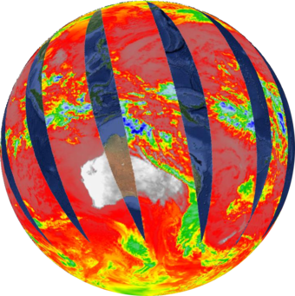
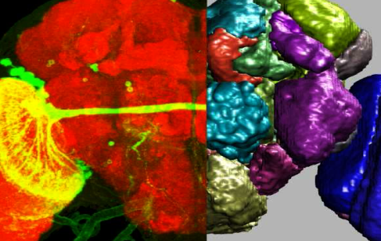
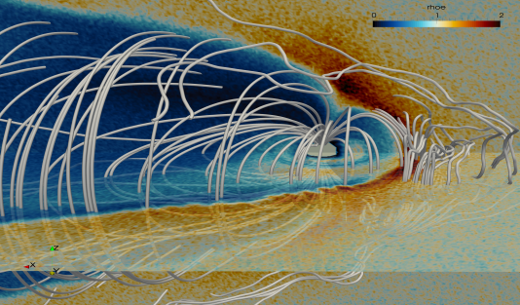
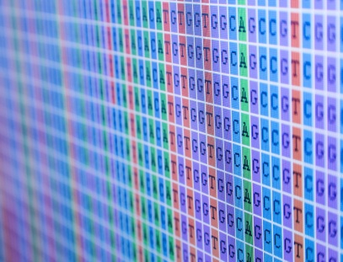
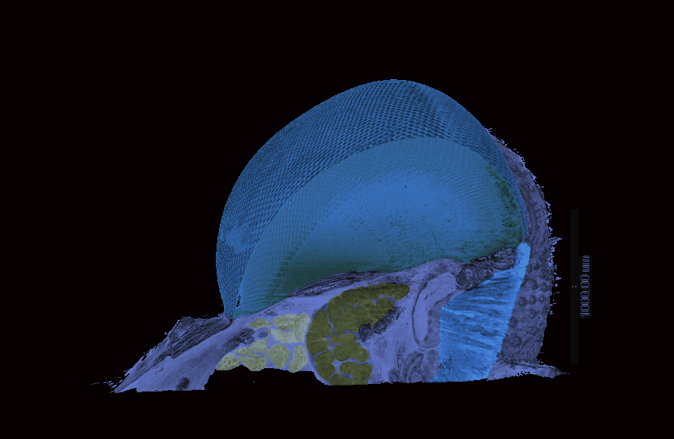
SAGE Co-Design
Primary Goal
Demonstrate Use Cases & Co-Design the system
Methodology
Obtain Requirements from:
Satellite Data Processing
Bio-Informatics
Space Weather
Nuclear Fusion (ITER)
Synchrotron Experiments
Data Analytics Application
Detailed profiling supported by Tools
Feedback requirements from platform

Slide 11
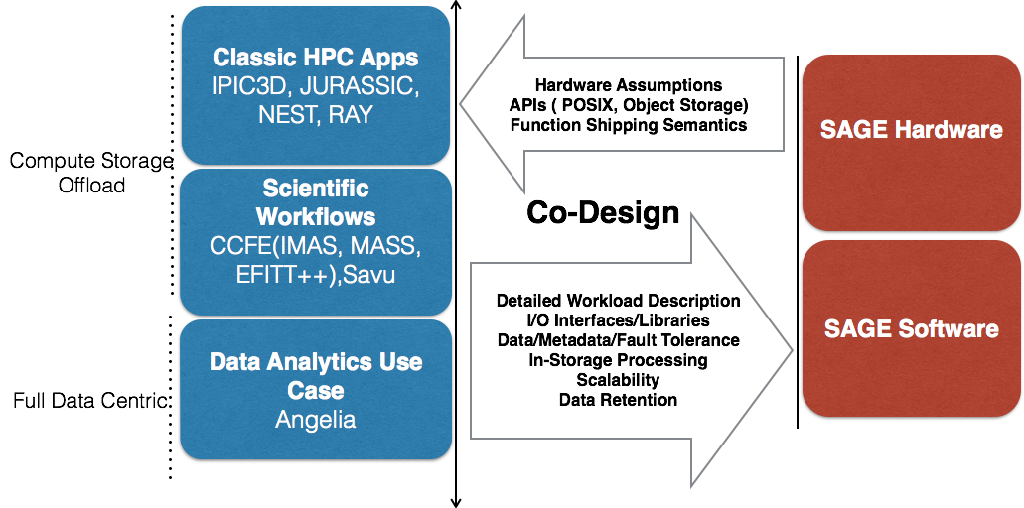
SAGE Co-Design..
Completed Co-Design Process – First Phase

Slide 12
Services, Systemware & Tools
Goal
Explore tools and services on top of Mero
Methodology
“HSM” Methods to automatically move data across tiers
“pNFS” parallel file system access on Mero
Scale out Object Storage Integrity checking service provision
Allinea Performance Analysis Tools provision
Completed Design of HSM
Completed Design of pNFS
Completed scoping/Arch of Data Integrity Checking
Completed scoping/Arch of Performance Analysis Tools

Slide 13
Programming Models and Analytics
Goal
Explore usage of SAGE by programming models, runtimes and data analytics solutions
Methodology
Usage of SAGE through MPI and PGAS
Adapt MPI-IO for SAGE
Adapt PGAS for SAGE
Runtimes for SAGE
Pre/Post Processing
Volume Rendering
Exploit Caching hierarchy
Data Analytics methods on top of Clovis
Apache Flink over Clovis, looking beyond Hadoop
Exploit NVRAM as extension of Memory
MPI-IO for SAGE Design available
Runtimes design available
Framework for data analytics available
PGAS for SAGE being studied

Slide 14
Integration & Demonstration
Goal
Hardware definition, integration and demonstration
Methodology
Design and Bring-up of SAGE hardware
Seagate Hardware
Atos Hardware
Integration of all the software components
From WP2/3/4
Integration in Juelich Supercomputer Center
Demonstrate use cases
Extrapolate performance to Exascale
Study other Object stores vis-à-vis Mero
Design & Definition of base SAGE hardware complete
Prototype being tested in Seagate

Slide 15
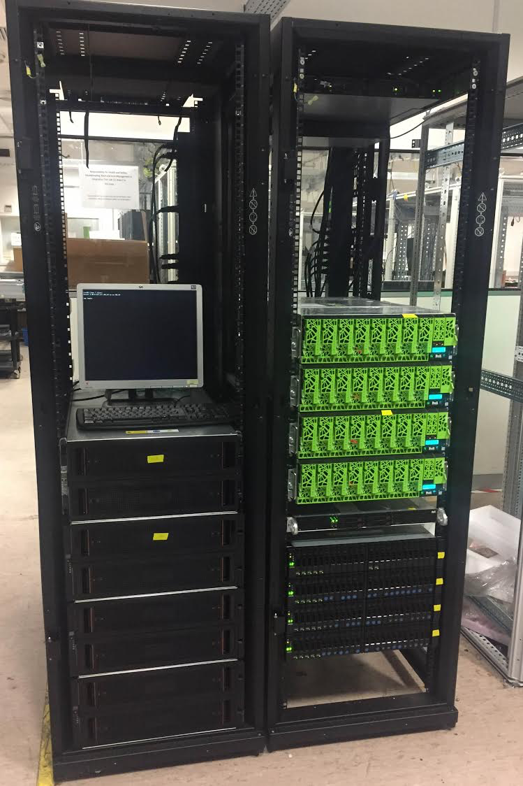
SAGE Prototype Ready for Shipping to Juelich

Slide 16
Overall Project Timeline
M1 (Sept 2015) – Project Start
M3 – Draft System architecture
M9 – Co-Design Inputs from Apps Complete
M12 – Design of Key Software Components ( 1st Draft)
M18 – Prototype system available ( Seagate)
M27 – Design of All Software Components ( 2nd Draft)
M18 – M28 – Prototype system testing/system integration in Juelich
M28 – M36 – Application use cases and performance tests of the SAGE Platform in Juelich

Slide 17
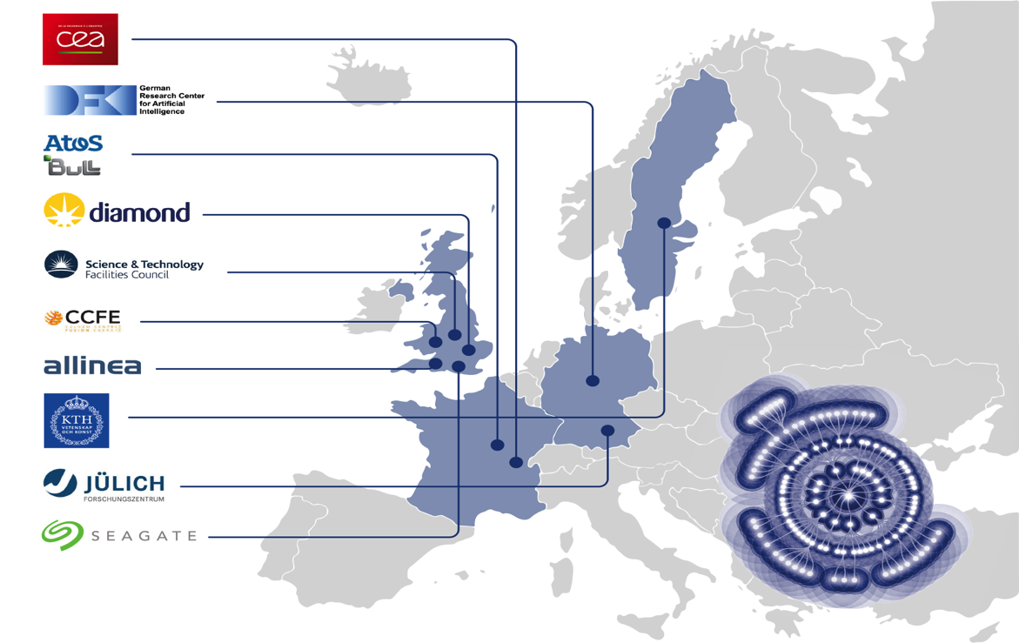
Consortium
Coordinator: Seagate
Notes:
Needs to be part of Malcolm’s introduction

Slide 18
Questions ?
giuseppe.congiu@seagate.com
sai.narasimhamurthy@seagate.com

