Slide 1
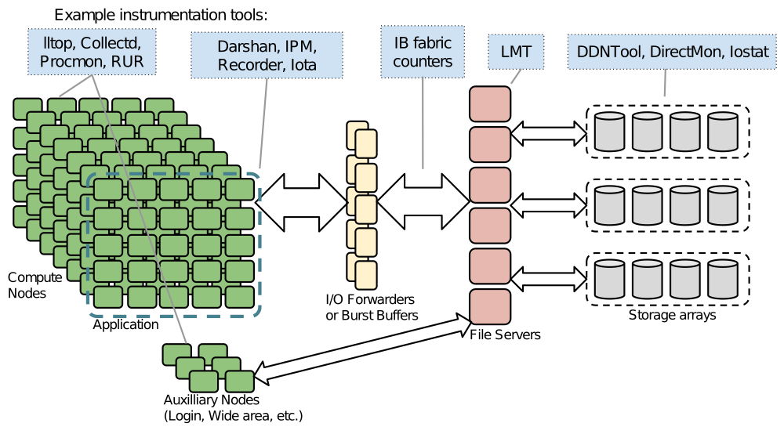
Leveraging holistic characterization for insights into Hpc i/O behavior
UIOP 2017
erhtjhtyhy
Shane Snyder
Argonne National Laboratory
ssnyder@mcs.anl.gov
Understanding I/O Performance Behavior Workshop
March 22-23, 2017 -- DKRZ Hamburg, Germany

Slide 2
Understanding hpc i/o behavior
Attempting to understand I/O performance on current HPC systems can be an overwhelming task
  Proliferation of I/O libraries and middleware
  Diverse system architectures:
    Storage technology (PFS, burst buffer, NVM)
    Interconnects
  Resource contention
Instrumentation of individual components of the I/O stack provides limited perspective on I/O behavior

Slide 3
Understanding HPC i/o behavior
A “holistic” approach
Holistic characterization of the entire HPC I/O subsystem is necessary for deep understanding of behavior
However, this type of approach exposes a new set of challenges:
  Lightweight data collection
  Reconciling data of differing format, resolution, and scope
  Defining effective metrics for quantifying end-to-end I/O performance

Slide 4
TOKIO
TOtal Knowledge of I/O
Vision: Provide a framework for holistic characterization and analysis of HPC I/O workloads
  Collect, integrate, and analyze disparate I/O data
  Define a platform-independent blueprint for deploying and utilizing I/O characterization tools, data collection/storage services, and analysis methods
  Provide a trove of relevant data characterizing HPC I/O workloads
Stakeholders:
  Application scientists (productivity)
  Facility operators (efficiency)
  Researchers (optimization)
  Procurement (resource planning)
TOKIO project is a collaboration between LBL and ANL
PI: Nick Wright (LBL)
Collaborators:
Suren Byna, Glenn Lockwood, Prabhat, Wucherl Yoo (LBL)
Philip Carns, Matthieu Dorier, Kevin Harms, Zach Nault, Robert Ross, Shane Snyder (ANL)

Slide 5
EXAMPLE TOKIO INSTRUMENTATION SOURCES

Slide 6
Application i/o characterization
Darshan provides lightweight characterization of HPC application workloads
  Captures I/O access pattern details using condensed counters and summary timing data
Design amenable to full-time deployment on production systems
Recent work in modularizing architecture to allow new instrumentation modules to be easily integrated
  I/O libraries, client-side FS data, etc
A new Lustre module allows us to characterize workload interaction with the FS to identify potential system inefficiencies

Slide 7
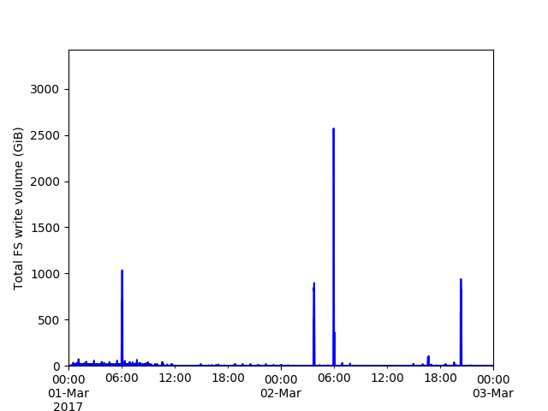
Continuous File system monitoring
Monitoring an I/O workload’s interaction with underlying storage resources can provide further context into I/O behavior
  How does our workload map to storage resources?
  What types of traffic (I/O operations, intensity) are being injected by competing jobs?
  How does competing traffic affect I/O performance of our reference job?
Production FS monitoring tools:
  LMT (Lustre monitoring tool)
  ggiostat
    GPFS monitoring tool developed at the ALCF
  Key FS counters monitored at 5-sec intervals
    Example: bytes read/written, IOP counts, server CPU load, etc.
    Per-server or system-wide granularity
mira-fs1 write traffic over 3 days using 1 minute intervals

Slide 8
ACHIEVING TOKIO IN PRACTICE

Slide 9

Compute
I/O
Storage
Burst Buffer
Slide courtesy of Glenn Lockwood/Nicholas Wright
9

Slide 10
MySQL
Elastic
Compute
I/O
Storage
Darshan records
collectd records
LMT records
…
Scalable Collection
view
view
view
view
view
I/O Telemetry
Data
Burst Buffer
Scalable Collection | RabbitMQ
Correlated view analysis
Contention detection
Record Formats | Darshan logs, HDF5
Query
Interface
Views | Index on time, job id, topology
Analysis Modules | Apache Spark
Slide courtesy of Glenn Lockwood/Nicholas Wright
10

Slide 11
Benchmarking for tokio

Slide 12
TOKIO ABC (Automated benchmark collection)
Periodic performance regression testing for HPC systems
Performance regression testing enables characterization of a platform’s I/O performance and variability over time
  A fixed set of reference benchmarks can be observed over time to uncover ground truths on I/O subsystem behavior
TOKIO ABC is currently running daily on the Mira system at the ALCF & the Edison system at NERSC
  Testing framework can be implemented using a CI system like Jenkins, or a simple cron job
TOKIO ABC Benchmarks
IOR shared-file using MPI-IO
VPIC-IO shared file using H5Part
IOR file-per-process using POSIX
HACC-IO file-per-process using GLEAN

Slide 13
Configuring TOKIO ABc
Determining suitable job parameters is a non-trivial, system dependent task
  E.g., Mira IBM BG/Q vs Edison Cray XC30
    Mira has fixed ratios of compute partitions to I/O nodes
      Higher I/O performance depends on larger CN partitions
    Edison’s CNs have high-radix (dragonfly) connects to many LNET routers
      Storage server bandwidth can be saturated with considerably less CNs
Tradeoff: large jobs with high I/O volumes tend to achieve higher I/O performance, but can queue indefinitely depending on system load
  We opt for job sizes that move quickly through queues, ensuring consistent sampling of the I/O subsystem
  Benchmark I/O volumes were selected s.t. each runs for ~2 minutes

Slide 14
Applying TOKIO FOR HPC I/O INSIGHTS

Slide 15
Applying TOKIO
Defining performance expectations
“acceptable” bounds on I/O performance depend on a number of factors:
  Workload characteristics
    Job size
    I/O strategy
  Contention from other jobs
  I/O subsystem health
An I/O fingerprint can help identify system I/O trends and provide insight into performance variations for classes of I/O workloads on a specific platform
I/O “fingerprints” for TOKIO ABC write workloads on ALCF’s Mira & NERSC’s Edison platforms

Slide 16
Applying TOKIO
Detecting performance problems
With an understanding of an I/O workload’s typical performance variation, detecting the presence of a problem becomes straightforward
Historical views can provide context into application or system I/O performance trajectory for users & admins:
  Did application changes degrade I/O performance?
  Is system I/O performance degrading in general?
1 month view of I/O performance for the IOR-FPP workload on Mira

Slide 17
Applying TOKIO
Detecting performance problems
With an understanding of an I/O workload’s typical performance variation, detecting the presence of a problem becomes straightforward
Historical views can provide context into application or system I/O performance trajectory for users & admins:
  Did application changes degrade I/O performance?
  Is system I/O performance degrading in general?
1 month view of I/O performance for App C on Mira

Slide 18
We’ve detected an I/O Problem!
…now what?
We’ve outlined a method for defining the “climate” of a platform’s I/O subsystem
  Provides a point of reference for reasoning about I/O behavior at any moment
But, how can we use the “weather” of the I/O subsystem – i.e., its current state – to diagnose the root cause(s) for poor behavior?
We can leverage TOKIO’s holistic characterization and analysis tools to help reason about I/O performance given the current system “weather”
  Gather an application-level view of I/O behavior
  Correlate with data from different components of the I/O subsystem
    At minimum: FS monitoring data
    Ideally: network monitoring, FS health monitoring; job scheduler logs

Slide 19
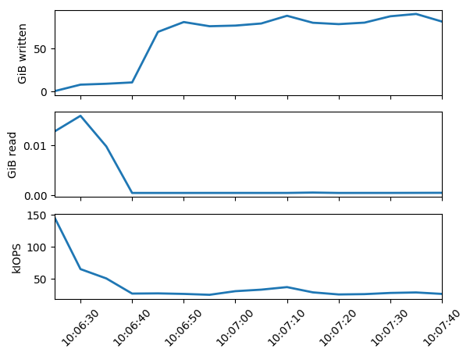
Applying tokio
Integrating holistic data sources
Extracting data from relevant instrumentation sources can give a clearer view of the state of the system while a target job was running
However, reconciling data provided by each instrumentation source is not an easy task:
  Converting between different formats
  Aligning distinct data sources temporally
  Handling of lossy or missing data
View of ggiostat counters overlapping with a TOKIO-ABC benchmark run on Mira

Slide 20
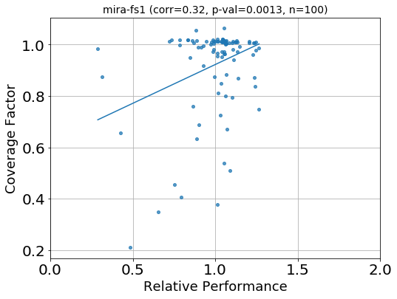
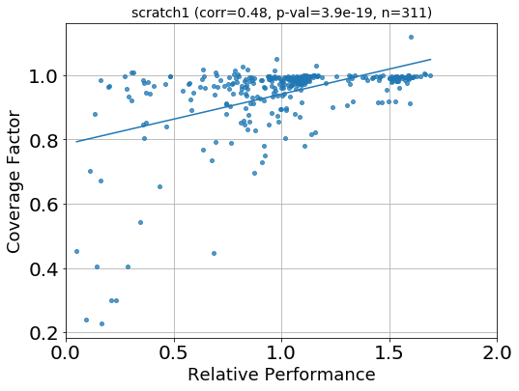
Applying tokio
Gleaning insight into HPC I/O behavior
Armed with a holistic understanding of I/O behavior, we can gain insight into individual workloads, system I/O trends, or even cross-system I/O trends
  E.g., how does system performance correlate with the amount of I/O contention a job experienced?
Plots comparing I/O performance and FS “coverage factor” for Mira and Edison FSes. Coverage factor is just the ratio of bytes moved by a job to the total bytes moved by the FS during the job time frame.

Slide 21
Conclusions
With little hope of lessening HPC I/O subsystem complexity, true understanding of I/O behavior will depend on a holistic approach to I/O characterization
TOKIO aims to standardize methods for deploying a holistic I/O characterization framework and to provide analysis tools offering meaningful insight into I/O behavior
  Define performance expectations for I/O workloads
  Detect workloads exhibiting poor performance
  Gather comprehensive I/O characterization data to determine root causes
Future work:
  Continue to add new and relevant data sources to our framework
  Develop platform-independent metrics and analysis methods to help us reason about I/O workload performance and I/O subsystem climate

Slide 22
Thank you for your time!
THIS WORK WAS SUPPORTED BY THE U.S. DEPARTMENT OF ENERGY, OFFICE OF SCIENCE, ADVANCED SCIENTIFIC COMPUTING RESEARCH, UNDER CONTRACT DE-AC02-06CH11357.
THIS RESEARCH USED RESOURCES OF THE ARGONNE LEADERSHIP COMPUTING FACILITY, WHICH IS A DOE OFFICE OF SCIENCE USER FACILITY SUPPORTED UNDER CONTRACT DE-AC02-06CH11357. This research also used resources of the National Energy Research Scientific Computing Center, a DOE Office of Science User Facility supported by the Office of Science of the U.S. Department of Energy under Contract No. DE-AC02-05CH11231.

