Slide 2
Topics
Hierarchical Storage architecture
Tape Storage introduction and history
LTO
    Generations
    Features
    Physical properties
LTFS

Slide 3
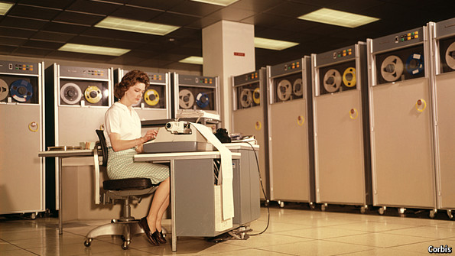
Tape Storage – an introduction
Tape storage seems antiquated
Made obsolete by HDDs due to size and speed?
Perception:
Image [1]
Notes:
Tape Storage – an introduction
Popular perception of tape storage is that of an old and obsolete technology. It is the oldest storage technology still in use today.
There are some benefits to tape storage in comparison to hard disk based storage that give reason to the continued development of the technology. Some of those are for example:
No power needed to preserve data (HDDs are similar in this regard but are rarely used as offline media due to portability reasons)
Data density (more data can be fit within the same volume)
Portability (tape cartridges can be easily transported – e.g. to secure locations geographically apart from the backed-up data center)
Cost per stored Byte is lower
Source: http://www.economist.com/blogs/babbage/2013/09/information-storage
Image [1]: http://cdn.static-economist.com/sites/default/files/imagecache/full-width/images/2013/09/blogs/babbage/20130928_stp504.jpg

Slide 4
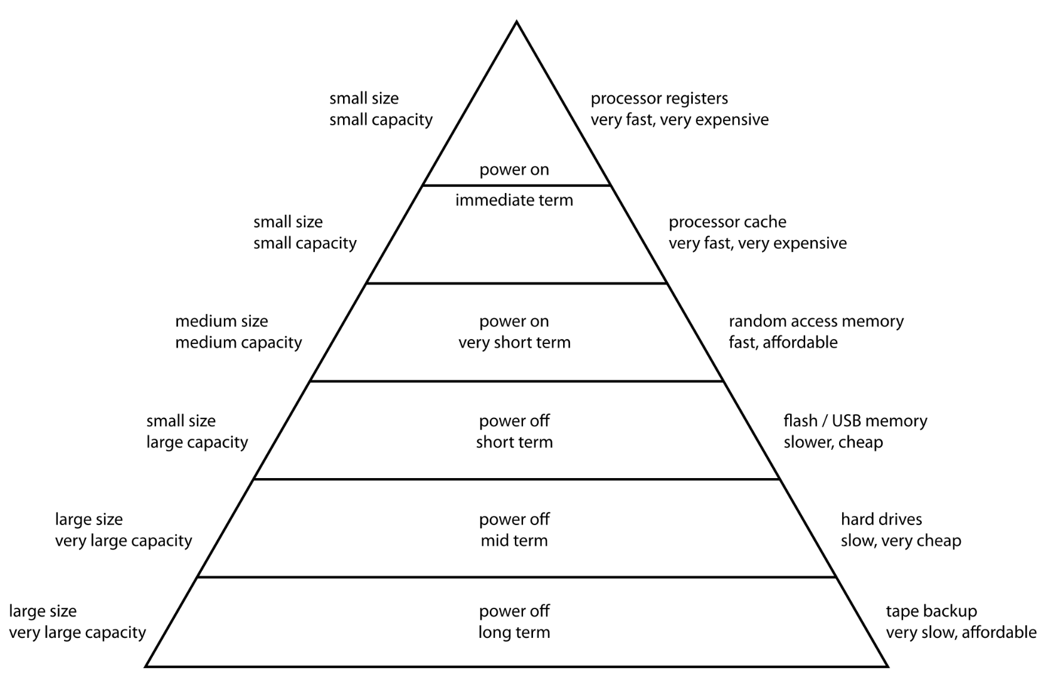
Hierarchical Storage Management
Cost vs. capacity
and performance
Cheap = big and slow
Expensive = small
and fast
Image [2]
Notes:
Hierarchical Storage Management
Tape storage is located at the bottom of the hierarchical storage model.
Storage is always a trade-off between cost, capacity, durability and performance. The decision which technology to use is based on weighing those factors against each other.
Small, expensive, volatile and very fast memories like CPU registers and caches which range up to a couple of Mbytes on one side of the spectrum versus relatively cheap, and comparatively slow non-volatile HDDs and tape-based storage on the other side.
Source: https://en.wikipedia.org/wiki/Hierarchical_storage_management
Image [2]: https://upload.wikimedia.org/wikipedia/commons/thumb/0/0c/ComputerMemoryHierarchy.svg/2000px-ComputerMemoryHierarchy.svg.png

Slide 5
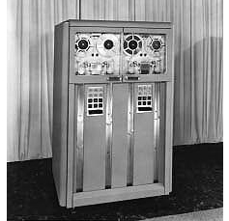
Tape Storage – early history
1951: Remington Rand UNISERVO - First Tape Storage for UNIVAC I
    Up to 224kb on 1200ft (365m) of metal tape @ 128 bit/inch
1952: IBM 7-track
    Up to 2.3 MB on 1200ft of oxide-coated
    plasitc tape @ 1400bit/inch²
    6 data + 1 parity track
    75 in/sec (1,9m/s) reached in 0.01 sec
- > fast replacement for punched cards
IBM 726
Image [3]
Notes:
Tape Storage – early history
Previously used punched cards proved to be too unreliable for data storage and offered a very low data density.
The very first commercial tape storage systems were introduced in the early 1950s. One system especially noteworthy is the UNISERVO since it was the mass storage system designed for the very first commercially available computer, the UNIVAC I. It stored data on heavy reels consisting of 1200ft long ¹⁄₂-inch-wide (13 mm) nickel-plated phosphor bronze tape. The material used for the tape was called Vicalloy and enabled for a storage capacity of 224kB.
A different early tape storage was the “7-Track” introduced by IBM for the 701 Data Processing System which also used ¹⁄₂-inch-wide tape. This system used non-metallic tape which made handling of the reels much easier and enabled the drive to accelerate the tape to full speed in only 1/100th of a second. It delivered a storage capacity of 2.3 MByte on a 1200ft reel. As can be seen on Image [3] one 726 drive was able to handle two reels simultaneously. This system was not available for purchase and could only be rented for 850 US$ per month.
Sources: https://en.wikipedia.org/wiki/UNIVAC_I
https://en.wikipedia.org/wiki/UNISERVO
https://en.wikipedia.org/wiki/Tape_drive
https://www-03.ibm.com/ibm/history/exhibits/701/701_1415bx26.html
Image [3]: https://www-03.ibm.com/ibm/history/exhibits/storage/images/coi63.jpg

Slide 6
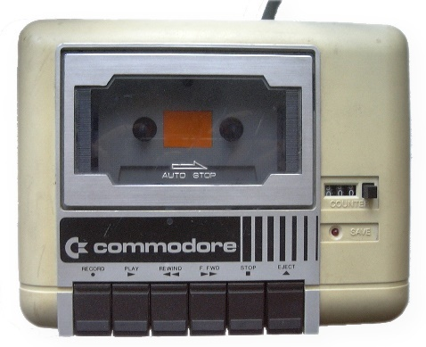

Tape Storage – history continued
1977: Commodore Datasette
    100 kByte/30 minute side (≈ 236 bit/inch)
    Up to 1MB with turbo tape and other fastloaders
1989: DDS
    Based on Digital Audio Tape
Image [4]
Format | DDS1 | DDS2 | DDS3 | DDS4 | DAT72 | DAT160 | DAT320
Date | 1989 | 1993 | 1996 | 1999 | 2003 | 2007 | 2009
Length (m) | 60/90 | 120 | 125 | 150 | 170 | 154 | 153
Capacity (GB) | 1.3/2 | 4 | 12 | 20 | 36 | 80 | 160
Speed (MB/s) | 0.183 | 0.72 | 1.5 | 3.2 | 6.9 | 12 | 16
Notes:
Tape Storage – history continued
The Commodore Datasette is mentioned here due to its very popular use in the consumer market. Other tape systems before that were used in datacenter environments and not available to the private consumer market due to cost, size and high power requirements. Compared to the very first tape storage systems (UNISERVO and IBM 726) it had a similar data density but could store less data because of the usually shorter tape lengths.
Since it stored data on widely available regular audio compact cassettes it was easily possible to listen to a data recording by playing it back on an audio tape deck – the “data-music” sounded much like the modulated signals generated by acousic-couplers or modems. Software called fastloaders or turbo-tape used more efficient encoding schemes to store more data and increased transfer rates to and from the tape without the need for hardware modifications.
The Digital Data Storage (DDS) was also originally based on audio tape (Sony’s “Digital Audio Tape”). The first versions had cartridges with 60 or 90 meters of 3.81mm wide tape. The later iterations DAT160 and DAT320 utilized 8mm wide tape.
Sources: https://en.wikipedia.org/wiki/Commodore_Datasette
https://en.wikipedia.org/wiki/Digital_Data_Storage
Image [4]: https://en.wikipedia.org/wiki/Commodore_Datasette#/media/File:Commodore-Datassette.jpg

Slide 7
Tape Storage – “Supertapes”
Demand for rising capacity in datacenter environments
1996: AIT – Advanced Intelligent Tape
    Dual-reel 8mm cartridges
    Up to 400 GB, 48 MB/s (AIT-5; AIT-6 cancelled)
2003: Super AIT (SAIT)
    Single-reel ½“ (12.7mm) cartridges
    Up to 800GB, 45MB/s SAIT-2 in 2006
DLT and SDLT (Digital Linear Tape)
    Single-reel ½“ (12.7mm) cartridges
    Up to 800GB, 60MB/s on S4-cardridges in 2007
Notes:
Tape Storage – “Supertapes”
The continued need for increases in storage capacity lead to the development of so called Supertapes which aimed to compete with the popular DDS/DAT drives. The first open reel technologies such as UNISERVO and IBMs 72x were replaced by more compact and easier to handle tapes in cartridge- or cassette-based enclosures and became popular in the 1980s. The first tapes in cartridges were used by IBMs 7340 1-inch Hypertape drive which was introduced in 1961. Another notable format was Exabyte corporation’s Data8 which was based on Sony’s 8mm video tape cassettes.
All of the early “Supertape”-formats such as (S)AIT and (S)DLT peaked at 800GB native capacity and are discontinued as of now.
Sources: https://en.wikipedia.org/wiki/Advanced_Intelligent_Tape
https://en.wikipedia.org/wiki/Digital_Linear_Tape
https://en.wikipedia.org/wiki/Magnetic_tape_data_storage
https://en.wikipedia.org/wiki/Linear_Tape-Open

Slide 8
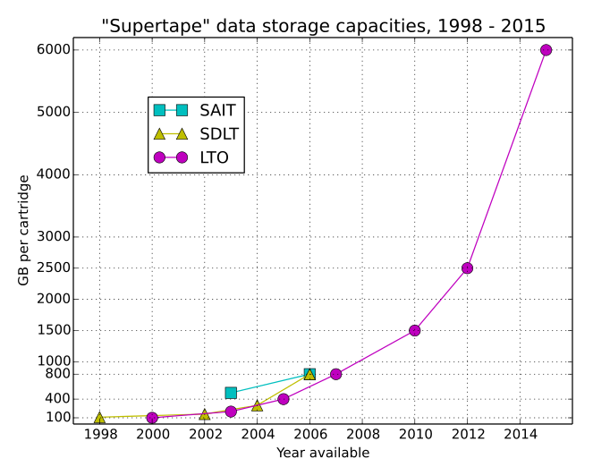
The advent of LTO
Open standard controlled by LTO consortium
    LTO = Linear Tape-Open
    consortium consists of
    HP, IBM and Quantum
    LTO-1 Released in 2000
    Development of “Supertape” capacities:
    LTO-7 @ 1,330 Mbit/inch
    translates to 166 MByte/inch
    ≈ 10,000,000-fold increase since UNISERVO
    @ 128 bit/inch
Image [5]
Notes:
The advent of LTO
The companies HP, IBM and Quantum founded the LTO consortium in the late 1990s to develop an open standard for tape storage. Other technologies and formats available at the time were proprietary to their respective companies.
The chart illustrates the exponential growth in native (uncompressed) storage capacity starting from 100GB per cartridge beginning with the first-generation (LTO-1) up to 6000GB on the current LTO-7 drives which were released in December 2015.
LTO density calculation: 960m tape length = 37795.3 in
6 TB (capacity for LTO7) = 48 Tbit
48Tbit = 49152 Gbit = 50331648 Mbit
50331648 Mbit/37795.3 in ≈ 1330 Mbit/inch
Source: https://en.wikipedia.org/wiki/Linear_Tape-Open
Image [5]: https://en.wikipedia.org/wiki/Linear_Tape-Open#/media/File:Supertape_data_storage_capacities.svg

Slide 9
LTO generations
 | LTO-1 | LTO-2 | LTO-3 | LTO-4 | LTO-5 | LTO-6 | LTO-7 | LTO-8 | LTO-9 | LTO-10
Release date | 2000 | 2003 | 2005 | 2007 | 2010 | 2012 | 2015 | TBA | TBA | TBA
Native data capacity | 100 GB | 200 GB | 400 GB | 800 GB | 1.5 TB | 2.5 TB | 6.0 TB | 12.8 TB | 26 TB | 48 TB
Max. uncompressed speed (MB/s) | 20 | 40 | 80 | 120 | 140 | 160 | 300 | 427 | 708 | 1100
Compression capable? | Yes, "2:1" |  |  |  |  | Yes, "2.5:1" |  | Planned, "2.5:1"
WORM capable? | No |  | Yes |  |  |  |  | Planned
Encryption capable? | No |  |  | Yes |  |  |  | Planned
Max. number of partitions | One (no partitioning) |  |  |  | two | four |  | Planned
Notes:
LTO generations
The table shows how LTO progressed throughout its generations. It was possible to achieve a 60-fold capacity increase and a 15-fold speedup in the 15 years since the first LTO-1 drives were available. Other important steps were the introduction of WORM and encryption capabilities as well as the possibility for partitioning of the tape starting with LTO-5.
The goals for the future capacities are already set for LTO-8 through LTO-10. Since the development of every new generation until now took about 2-3 years we can expect the introduction of the next LTO standards probably around 2018 (LTO-8), 2021 (LTO-9) and the mid-2020s for LTO-10.
For easier recognition, every generation uses different typical colors for the cartridges, although they are not standardized.
Source: https://en.wikipedia.org/wiki/Linear_Tape-Open

Slide 10
LTO backward compatibility
Requirement for compatibility was maintained throughout generations 1-7
Write: current and last generation
Read: current and last two generations
LTO-7 drives e.g. are capable of:
    Reading Ultrium 7 (6000 GB)
    Reading Ultrium 6 (2500 GB)
    Reading Ultrium 5 (1500 GB)
    Writing Ultrium 7
    Writing Ultrium 6
Notes:
LTO backward compatibility
Throughout all generations LTO maintained the same scheme of backward compatibility requirements for its drives.
All drives have to be able to read data off the current and previous two generations as well as to have the capability to write to the current and last generation cartridges.
Source: https://de.wikipedia.org/wiki/Linear_Tape_Open

Slide 11
LTO compression
LTO 1-5: LTO-DC aka Streaming Lossless Data Compression (SLDC)
    Based on Lempel–Ziv–Stac (LZS, aka Stac compression)
    Average compression ratio 2:1
LTO 6 + 7: Same algorithm
    Average claimed compression ratio 2.5:1 due to larger dictionary
Detection of incompressible data
    Compares uncompressed vs. compressed data
    Header of every data block indicates whether compression was used
Notes:
LTO compression
All LTO generations starting from LTO-1 support hardware-based compression which has to be implemented by every compatible drive. The claimed average compression ratio was 2:1 for LTO-1 through 5 and was increased to 2.5:1 since LTO-6. Although the basic algorithm SLDC as a variation of LZC stayed the same, the better ratio was achieved by increasing the dictionary size that the algorithm can utilize.
SLDC is able to detect whether data is sufficiently compressible by applying the compression to every data block that is about to be written and comparing its size to the original data. If the ratio between those sizes is below a certain threshold the data is either already compressed or random enough and will therefore be written without compression. This is performed for every block separately and the result whether compression was used is written to the respective header of every block. This is to enable the drive to interpret the data correctly when reading from the tape.
Source: https://en.wikipedia.org/wiki/Linear_Tape-Open

Slide 12
LTO - other features
WORM – Write Once, Read Many (≥ LTO-3)
    Suitable for long term archives of legal documents e.g.
    LTO drive will not overwrite or erase WORM media
    Same cartridge, built-in memory identifies WORM media
Encryption (≥ LTO-4)
    Application-managed AES-128 (aka Rijndael)
Partitioning (≥ LTO-5)
    Division of a tape in separate areas – as used in HDD-partitioning
    necessary for LTFS!
Notes:
LTO – other features
Introduced with the 3rd LTO generation were WORM cartridges which are only able to be written on once. This is a feature required for certain long-term storage applications where it is necessary to protect the data from accidental deletion or tampering, in some cases for legal reasons. In addition to the regular write-protect switch on any LTO-cartridge the built-in factory-written RFID-chip classifies a media as WORM. The other physical properties of the tape and cartridge remain the same as regular non-WORM media.
The Encryption which was supported beginning with LTO-4 uses AES-128. The standard defines that every LTO-compatible drive from generation 4 upwards has to be able to recognize and read encrypted tapes, although the ability to perform the encryption itself is not required. The symmetric encryption algorithm uses the same key for encryption and decryption. The key itself is being provided by the application accessing the drive using either a proprietary protocol or an open standard like the OASIS KMIP.
The partitioning feature introduced with LTO-5 (2 partitions) and extended in generation 6 (4 partitions) enabled the tapes to be logically subdivided and made formatting using the new Linear Tape File system (LTFS) possible.
Sources: https://en.wikipedia.org/wiki/Linear_Tape-Open
https://en.wikipedia.org/wiki/Key_Management_Interoperability_Protocol

Slide 13
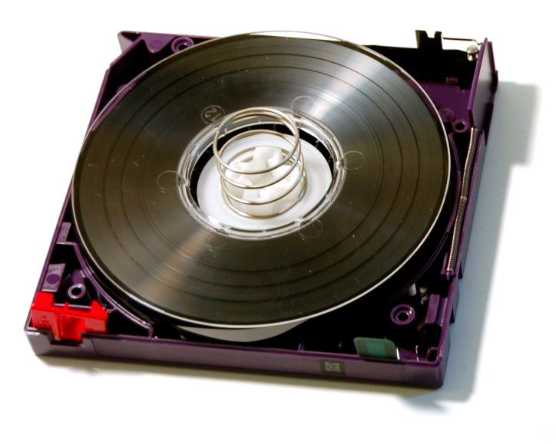
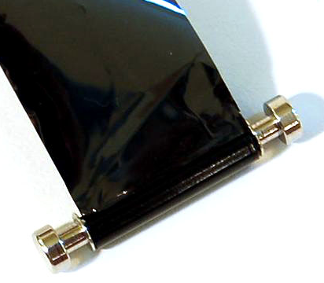
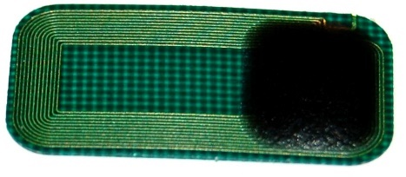
Ultrium – physical features
Single-reel
Physical write-protection switch
Built-in EEPROM
    Blocks of 32 bytes
    4kB in Ultrium 1-3 (128 blocks)
    8kB in Ultrium 4 + 5 (255 blocks)
    16kB in Ultrium 6 + 7 (511 blocks)
    RF-Interface (@13.56 MHz)
    Used to store identification data,
    tape generation, tape use-statistics
Image [6]
Image [7]
Image [8]
Notes:
Ultrium – physical properties
Ultrium is the brand name for LTO tape cartridges of any generation. To make the media easier to recognize, manufacturers of LTO cartridges use different colors for every generation. Unfortunately, the coloring scheme is not standardized. Every cartridge has a memory chip inside it which is made up of 511 (LTO 6+7), 255 (LTO 4+5), or 128 (LTO 1-3) blocks of memory, where each block is 32 bytes for a total of 16 KB, 8 KB or 4 KB, respectively. Cleaning cartridges, which should be used regularly to clean the read/write-heads of the drives contain a 4KB Memory module. These memory modules can be accessed by the drive, one block at a time, via a non-contacting radio interface operating at 13.56 MHz with a range of about 2cm. The memory is used to identify tapes, to help drives distinguishing between different generations of the technology, and to store tape-use information. There are also standalone readers available for cartridge management in tape libraries.
Since the cartridges are single-reeled, one end of the tape has a lead pin (Image [7]) by which the drive is able to pull the tape out of the cartridge.
Source: https://de.wikipedia.org/wiki/Linear_Tape_Open
Image [6]: https://en.wikipedia.org/wiki/Linear_Tape-Open#/media/File:LTO2-cart-wo-top-shell.jpg
Image [7]: https://en.wikipedia.org/wiki/Linear_Tape-Open#/media/File:LTO-leader-pin.jpg
Image [8]: https://en.wikipedia.org/wiki/Linear_Tape-Open#/media/File:LTO-CM_top.jpg

Slide 14
Ultrium media properties
 | LTO-1 | LTO-2 | LTO-3 | LTO-4 | LTO-5 | LTO-6 | LTO-7
Native data capacity | 100 GB | 200 GB | 400 GB | 800 GB | 1.5 TB | 2.5 TB | 6.0 TB
Tape length | 609 m |  | 680 m | 820 m | 846 m |  | 960 m
Tape width | ½“ = 12.650 mm ± 0.006 mm
Tape thickness | 8.9 µm |  | 8 µm | 6.6 µm | 6.4 µm | 6.1 µm | 5.6 µm
Magnetic material | Metal Particulate (MP) |  |  |  |  | MP or BaFe | BaFe
Data bands per tape | 4
Wraps per band | 12 | 16 | 11 | 14 | 20 | 34 | 28
Tracks per wrap | 8 |  | 16 |  |  |  | 32
Total tracks | 384 | 512 | 704 | 896 | 1280 | 2176 | 3584
Linear density (bits/mm) | 4880 | 7398 | 9638 | 13,250 | 15,142 | 15,143 | 19,094
Data-Encoding | RLL 1,7 | RLL 0,13/11; PRML |  |  | RLL 32/33; PRML | RLL 32/33; NPML
End-to-end passes required to fill tape | 48 | 64 | 44 | 56 | 80 | 136 | 112
Expected tape durability, end-to-end passes | 9600 | 16,000 | 16,000 | 11,200 | 16,000
Notes:
Ultrium media properties
It is noteworthy how due to advances in material science it was possible to steadily increase the data density and therefore, capacity, on the tapes throughout the generations without changing the width of the tape. There are a couple of parameters which enable increases in capacity:
Number of Tracks
Tape thickness and length (more thin tape fits into the same size cartridge)
Granularity of the magnetic material
The cartridges themselves were not changed – a LTO-1 Ultrium cartridge physically fits into a LTO-7 drive and vice versa.
Source: https://en.wikipedia.org/wiki/Linear_Tape-Open

Slide 15
LTO – Bands, Wraps and Tracks
Servo track
Track 0
Track 1
Track 2
Track 3
Track 4
Track 5
Track 6
Track 7
Track 8
Track 9
Track 10
…
Track 21
Track 22
Track 23
Track 24
Track 25
Track 26
Track 27
Track 28
Track 29
Track 30
Track 31
Servo track
Physical tape structure
LTO-7
Wrap 0 ↔
Wrap 1 ↔
Wrap 2 ↔
Wrap 3 ↔
Wrap 4 ↔
Wrap 5 ↔
Wrap 6 ↔
Wrap 7 ↔
Wrap 8 ↔
…
Wrap 19 ↔
Wrap 20 ↔
Wrap 21 ↔
Wrap 22 ↔
Wrap 23 ↔
Wrap 24 ↔
Wrap 25 ↔
Wrap 26 ↔
Wrap 27 ↔
Servo track
Band 3
Servo track
Band 1
Servo track
Band 0
Servo track
Band 2
Servo track
Read element | read-write head
32 r/w elements
Read element
Notes:
LTO – Bands, Wraps and Tracks
The LTO standard defines the physical layout of the tracks on the tape and differs for each generation. The term „linear“ means that the data is written in long tracks throughout the whole length of the tape. The example given is for the most recent implementation of the LTO-standard, LTO-7. The previous generations have a similar layout but with smaller amounts of wraps and/or tracks.
The tape itself is subdivided into 4 bands that are accompanied by thin factory-written servo tracks on each side to enable the drive to determine the current position on the tape as well as aligning the read/write head. Each band is further divided into wraps, which then contain the individual tracks.
The writing and reading is performed on a given wrap, which means that the drive‘s read/write-head is able to process all tracks simultaneously that comprise a wrap.
When writing to a tape, the drive starts on „band 0“ on „wrap 0“. Every wrap describes a U-shaped pattern which starts and ends at the very beginning of the tape (directly after the lead pin). To write one full wrap, the drive needs to spin the whole tape‘s length two times: from start to end to start.
Source: http://www.lascon.co.uk/Tape-Linear-Technology.php

Slide 16
LTO – data encoding
(1,7) RLL – Run-length limited
    (1,7) RLL maps 2 bits of data onto three bits on the medium
Data | Encoded
00 | 101
01 | 100
10 | 001
11 | 010
00 00 | 101 000
00 01 | 100 000
10 00 | 001 000
10 01 | 010 000
Data: | 0 0 1 0 1 1 0 1 0 0 0 1 1 0
Encoded: | 101 001 010 100 100 000 001
Notes:
LTO – data encoding
The data encoding method determines how data is being represented and stored. For any given stream of raw data comprised of „ones and zeroes“ a unique code is defined. The more efficient it is designed, the more data can be stored with less overhead. The encoded set of “ones and zeroes”, not the raw data, is written on the tape as an analog signal. The aim is to have unique and easily distinguishable codes for making the reading process and thus recovery of the data as little error-prone as possible. Some redundancy is always present in the encoding scheme for error correction.
Source: https://en.wikipedia.org/wiki/Run-length_limited

Slide 17
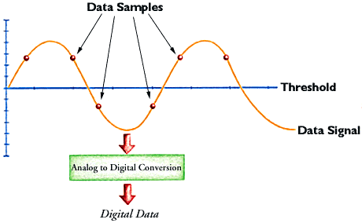
LTO – signal detection
PRML
(Partial-Response Maximum-Likelihood)
    Signal detection with “fuzzy”-logic:
NPML
(Noise-Predictive Maximum-Likelihood)
    “Super”-PRML with advanced algorithms to reduce the influence of noise
Image [9]
Notes:
LTO – signal detection
The data on a given tape is written as an analog signal. The drive‘s head reads this signal as samples of voltages and the data recovery algorithms try to determine the most probable original data. Since some kind of encoding is always used, (1,7) RLL e.g., not all possible measurements would represent a valid code. This is used to correct read errors. Due to the continuing increase in data density with every new generation of LTO drives and tapes, less magnetic particles are being used which leads to ever decreasing signal strengths. In comparison to other methods of signal detection such as peak detection, the PRML used in LTO drives allows for the correct interpretation of very weak signals with a low signal to noise-ratio. The more advanced NPML introduced with LTO-6 takes this approach further by computationally reducing the influence of noise and therefore enabling for the detection of even weaker signals.
Sources: https://en.wikipedia.org/wiki/Partial-response_maximum-likelihood
https://en.wikipedia.org/wiki/Noise-predictive_maximum-likelihood_detection
Image [9]: http://www.pcguide.com/ref/hdd/geom/z_q_peakdetection.gif

Slide 18
LTFS
Partitioning is necessary (≥ LTO-5)
Index Partition (e.g. 37.5 GB @ LTO-5)
    Metadata: file timestamps, permissions,
Data Partition
    Contains data and Metadata
Enables interoperability
    Prior to LTFS, application-specific databases were used to store metadata
    LTFS formatted cartridges can be used by all LTFS-compliant applications
    Tapes can be mounted and accessed in the same way as HDDs (even under Windows)
    Data is always written at the end, never overwritten or altered
Notes:
LTFS
The introduction of partitioning in LTO’s 5th generation made it possible to format tapes using the LTFS filesystem developed by IBM and taken up by the LTO-consortium in 2010. LTFS enables tapes to be accessed similar to any other removable storage such as USB flash drives. As a self-describing format it also allows for interoperability such that LTFS-formatted tapes can be used between different Operating Systems without the need for specific backup software. Drivers for Windows, Linux and MacOS are available from the tape drive manufacturers.
Sources: http://www.smallersystems.com/blog/2011/06/how-does-ltfs-work/
https://en.wikipedia.org/wiki/Linear_Tape_File_System

Slide 19
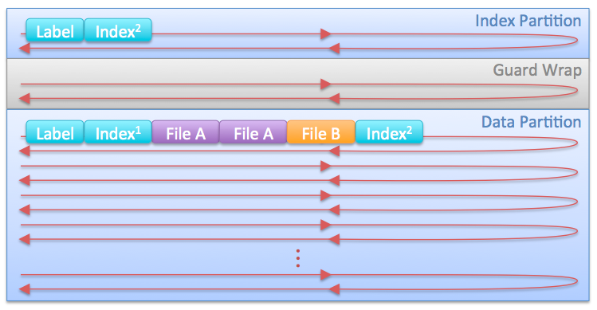
LTFS – logical layout
Image [10]
Notes:
LTFS – logical layout
The basic structure of a LTFS formatted media relies on two partitions – an Index Partition and a Data Partition. An empty guard wrap is placed between Index and Guard Partition as a reserve and to avoid accidental overwrites due to mechanical failures. The beginning of each partition contains its label, followed by the index. The index contains the file system‘s meta-data such as file and folder names, permissions and timestamps. Every time data is written to the tape, a new index has to be written as well. The Index Partition is being rewritten every time a new index is necessary and contains only the most recent version while the Data Partition – as its data is never overwritten - contains all previous copies and the most recent version at its end. Deletion of files is implemented by removing the entries from the index, not by physically deleting them from the Data Partition. Overwriting works in a similar fashion by adding the new version of a file to the Data Partition and changing the entry in the index to point to the most recent version.
Sources: http://www.smallersystems.com/blog/2011/06/how-does-ltfs-work/
https://en.wikipedia.org/wiki/Linear_Tape_File_System
Image [10]: http://www.smallersystems.com/blog/wp-content/uploads/2011/06/LTFS-Logical-Layout.png

